Slide 1

Selection Bias and Heckman Two-Stage Estimation
Michael Machiorlatti
Assistant Professor
Department of Biostatistics and Epidemiology
Hudson College of Public Health – OUHSC
Funded by OSCTR

Slide 2
Contents – What will be Covered
Introduction to the Problem (Selection Bias/Missing Data)
  Defining the scenario
  Example Applications Overall With Special Attention to Applications in Health Models.
  Simulations to Understand the Set Up
Methods-Based Solutions vs Analysis-Based Solutions
Introduction to Heckman Model – Analysis Based Solutions
Implementation in R manually and with sample Selection Package.
Multiple Imputation – Brief – For Comparison and Application
Supplement – All the code used
  Critical factors and methodological pitfalls to avoid – If Time
  Preview of our Heckman flowchart (From Statistics Lab Munster – see references) – If Time
Recommended literature

Slide 3
Problem
Selection bias occurs when a sample is not randomly generated and, thus, does not represent the population
Consequence: “The problem of selection bias [...] arises when a rule other than simple random sampling is used to sample the underlying population that is the object of interest. The distorted representation of a true population as a consequence of a sampling rule is the essence of the selection problem.” (Heckman, 2018, p. 12131)

Slide 4
Selection Bias
Selection bias: bias introduced when the selection of data for analysis does not represent the target population.
Sources: study participants, the investigators, external factors, etc.
Biased sample with no correction/adjustment produces biased estimates and inferences.

Slide 5
Selection Bias - Figure
Through some sampling mechanism, a sample is selected from the population.
A selection bias has occurred since the mechanism employed has over represented a portion of the population inside of the sample
Target Population
Sample

Slide 6
Problem
Example(s)
Example 1: Traditional Set Up (Economics/Finance) – Suppose you want to explore income and you have age and education data. Due to the nature of the data (i.e. sensitive for income) you only have some people revealing income. So, this is some type of censoring/missing data issue because you can only observe the final income revelation.
Example 2 Suppose you have corporate venture capital (CVC) investments, where researchers can only observe a firm’s final investment decision. However, the strategic decision of CVC may be based on characteristics that researchers cannot observe
Example 3: Suppose you are exploring some health outcome like severity of emergency condition and you have age, insurance and location data. Due to the nature of hospitals, you only observe some type of patients. For example, in OKC maybe many of the most extreme cases come to OUHSC.

Slide 7
Simulation to Illustrate Example
Suppose we draw 10,000 obs at random to simulate 10000 people in a given Population
We can consider education and make it uniform over [8,24]
Age uniform over [18,64]
**note we can just as easily consider a normal distribution (with some mean and SD). This does no influence our findings.
Suppose we are exploring BMI and it take the form:
Population Model: BMI= 18 -0.15*educ + 0.35*age + e
Avg: 30.0 SD = 4.9

Slide 8
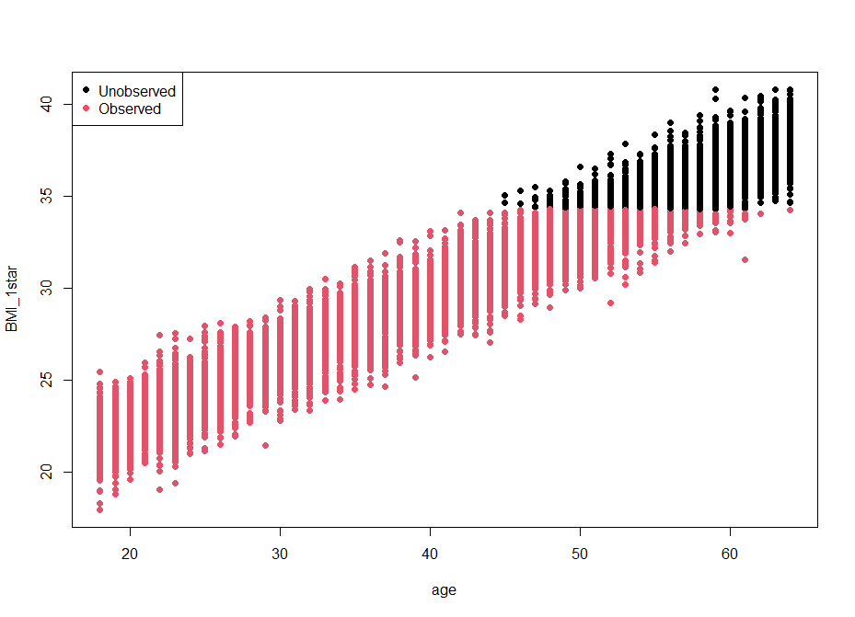
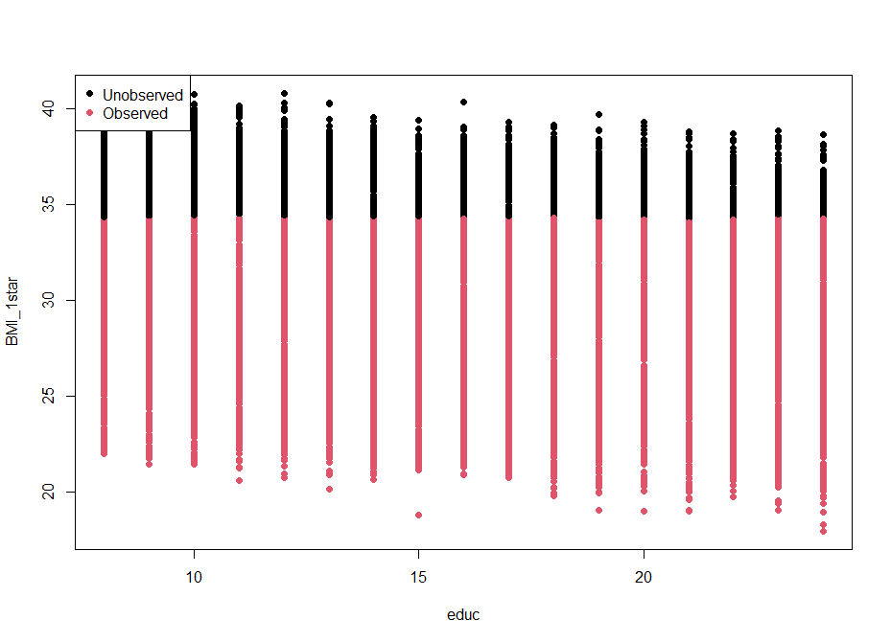
Population Plots – Observed vs Unobserved (25%)

Slide 9
Simulation to Illustrate Example
Generate missing data for BMI
Decision rule: BMI_1star < cutoff = 34.3 we observe; if not we don’t.
We have a strict truncation where we are not observing higher values of BMI.
BMI reported if d*≤34.6
BMI missing if d*>34.6
**in the classic example the decision rule is reversed since lower income is no observed/likely to report. It is arbitrary if the is censoring that is higher or lower. This simply changes the estimates but NOT the procedure. Additionally, Heckman uses a cutoff of 0 and a standardized normal value.
BMI(fully observed)→BMI(Sample Estimate) if fully observed with non-missing obs.

Slide 10
Model Assumptions – General Formulation
ε_{i} and v_{i} are assumed to be bivariate normal
E(ε_{i}) = E(v_{i}) =0
Var(ε_{i}) = σ²
Var(v_{i}) = 1
Cov(ε_{i},v_{i}) = ρ σ =0.6
(these parameters can be tweaked to observe changes to estimates)
Proposed Model: Y_{i} = β₀ + β₁educ_{i} + β₂age_{i} + ε_{i}
E[Y_{i} | SSR] = β₀ + β₁educ_{i} + β₂age_{i} +
E[ε_{i} | SSR]
E[ε_{i} | SSR] = E[ε_{i} | v_{i}<-w_{i}γ] = ρ σ φ(w_{i}γ)/Φ(w_{i}γ)
  **So given the selection rule we can see that the traditional estimate is “altered” by φ(w_{i}γ)/Φ(w_{i}γ)
  **So this means we MUST adjust our regression estimated to get unbiased results. If not, there will be this bias based on the selection rule used.

Slide 11
Regression Formulations
λ_{i} = φ(w_{i}γ)/Φ(w_{i}γ)
w_{i}γ = γ₀+educ γ₁+age γ₂
γ₂ and γ₃ are both constructed as the observed coefficient multiplied by λ_{i}
The omitted variable λ_{i} may be positively correlated with what is observed in the model or negatively associated with the observation depending on the cov(educ, λ_{i}) and cov(age, λ_{i})
Therefore, the coefficients on educ and age in the selected sample can be either too low or too high based on this formulation.

Slide 12
Methods Based-Solutions to Selection Bias
Study Set Up – In general on can employ a more robust sampling procedure to ensure that members of the entire target population is represented.
In some cases, where the selection is induced as in our example, this is not entirely possible. So, what might you do?
A: Consider stratum specific procedures to try and capture the entire population.
Analysis Phase
Complete Case Analysis - just run the regression on what you can observe (see regression results and formulation on prior slides where )
Use Heckman 2-Step Procedure to adjust regression estimates – We will focus on how to do this
Multiple Imputation (will do briefly to compare findings)

Slide 13
Methodology
The Heckman two-stage estimation supports identifying and mitigating a potential selection bias
This technique consists of two consecutively applied stages that separate the selection process from the primary relationship of interest
  In the first stage, the selection process of the underlying relationship is estimated
  The second stage analyzes the primary relationship of interest
  The connection between the two stages is a unique selection parameter induced from the first stage and inserted in the second-stage regression (Inverse Mills Ratio)
  The selection parameter captures unobservable characteristics found in the primary regression’s error term that lead to endogenous covariates

Slide 14
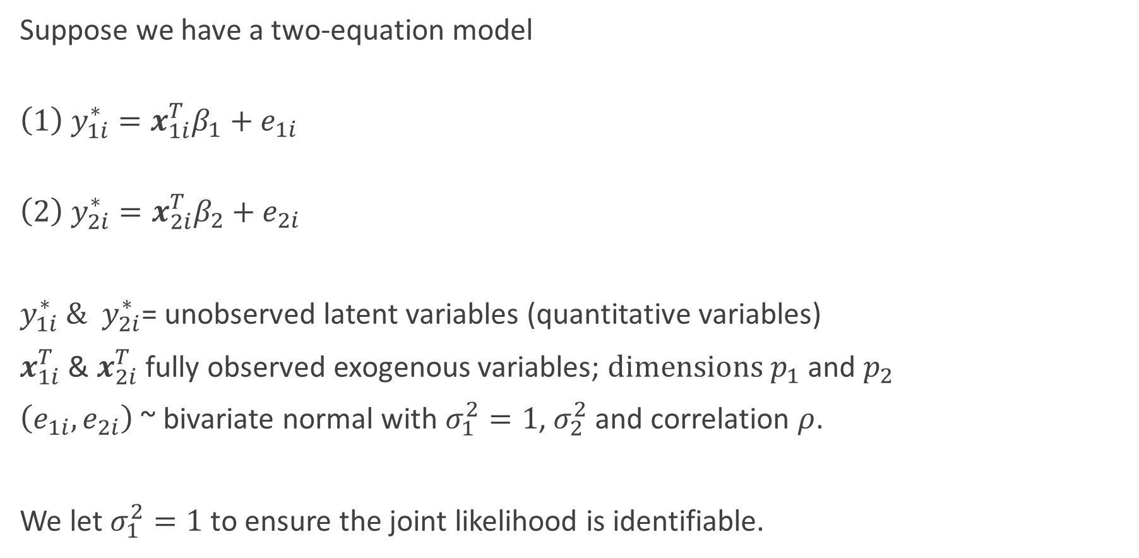
Heckman Model – Classical Set Up
Suppose we have a two-equation model
$$\left(1\right) y_{1i}^{∗}=x_{1i}^{T}β_{1}+e_{1i}$$
$$\left(2\right) y_{2i}^{∗}=x_{2i}^{T}β_{2}+e_{2i}$$
$y_{1i}^{∗}{ \& y}_{2i}^{∗}$= unobserved latent variables (quantitative variables)
$x_{1i}^{T}$ & $x_{2i}^{T}$ fully observed exogenous variables; $dimensions p_{1}$ and $p_{2}$
$\left(e_{1i},e_{2i}\right)$ ~ bivariate normal with $σ_{1}^{2}=1$, $σ_{2}^{2}$ and correlation $ρ$.
We let $σ_{1}^{2}=1$ to ensure the joint likelihood is identifiable.

Slide 15
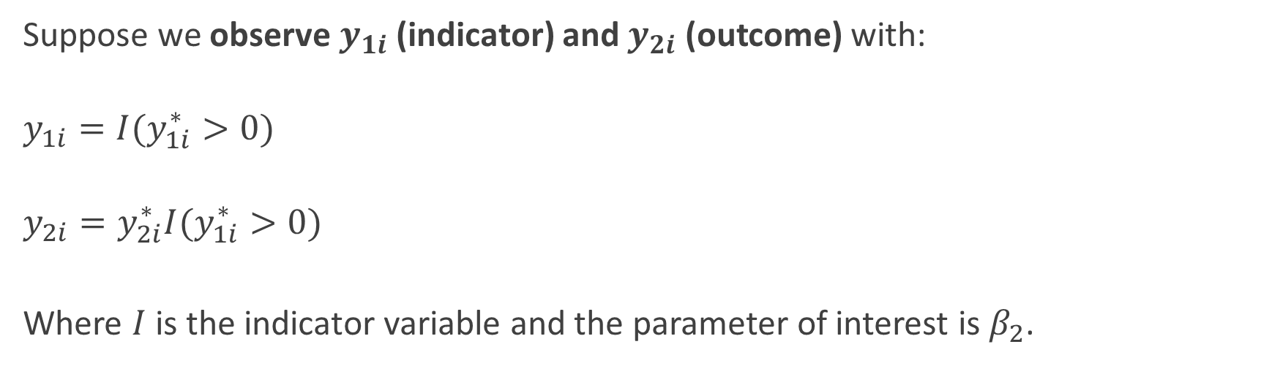
Set Up
Suppose we observe $y_{1i}$ (indicator) and $y_{2i}$ (outcome) with:
$$y_{1i}=I(y_{1i}^{∗}>0)$$
$$y_{2i}=y_{2i}^{∗}I(y_{1i}^{∗}>0)$$
Where $I$is the indicator variable and the parameter of interest is $β_{2}$.

Slide 16
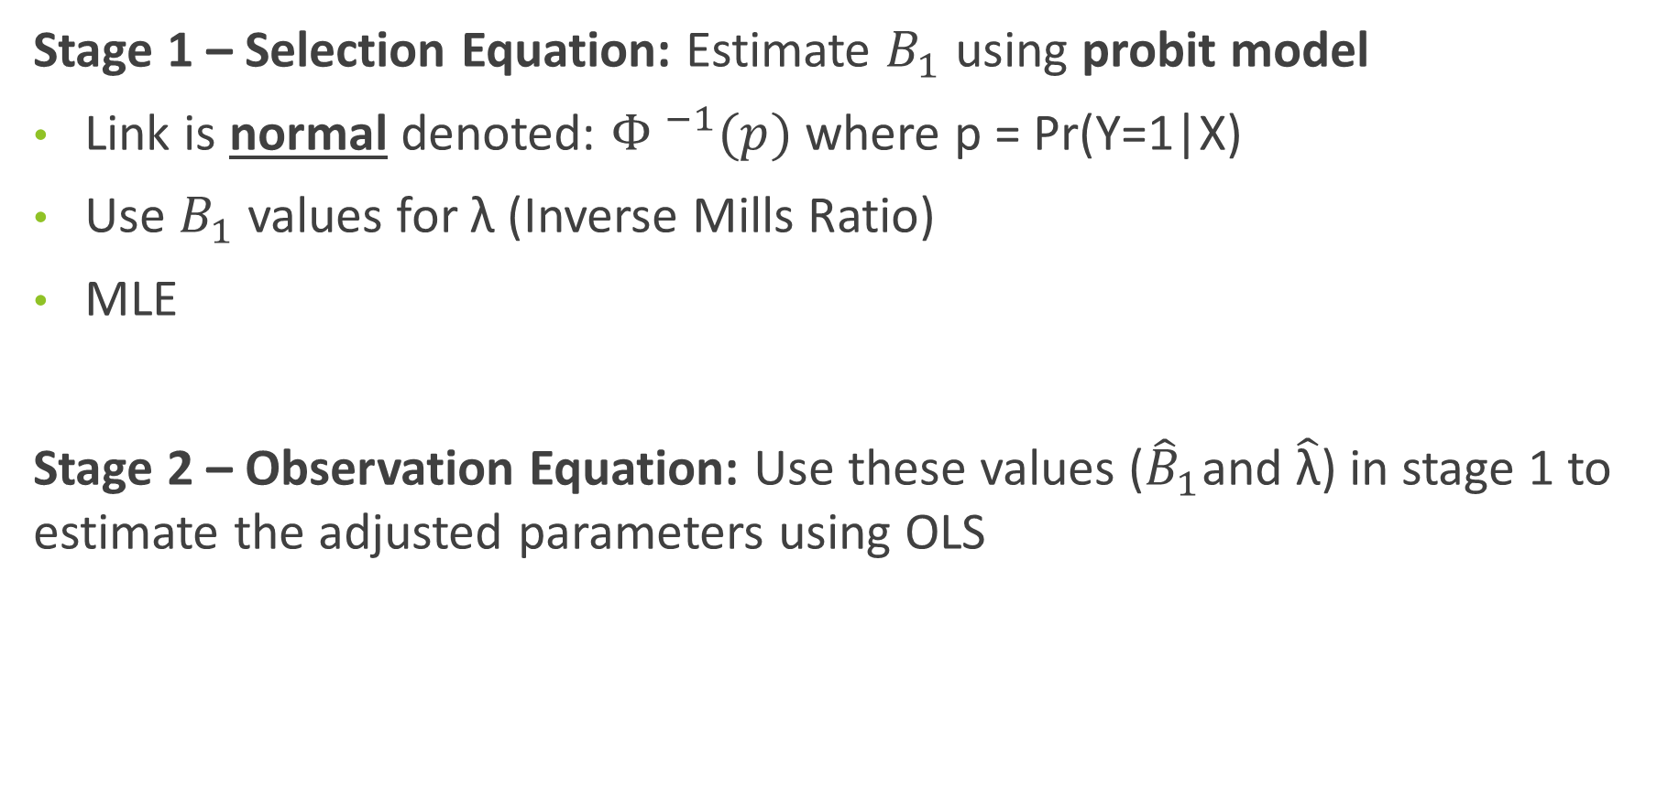
Heckman Correction -Two stage procedure:
Stage 1 – Selection Equation: Estimate $B_{1}$ using probit model
Link is normal denoted: ${Φ }^{−1}(p)$ where p = Pr(Y=1|X)
Use $B_{1}$ values for λ (Inverse Mills Ratio)
MLE
Stage 2 – Observation Equation: Use these values (${\hat{B}}_{1}$and $\hat{\text{λ}}$) in stage 1 to estimate the adjusted parameters using OLS

Slide 17
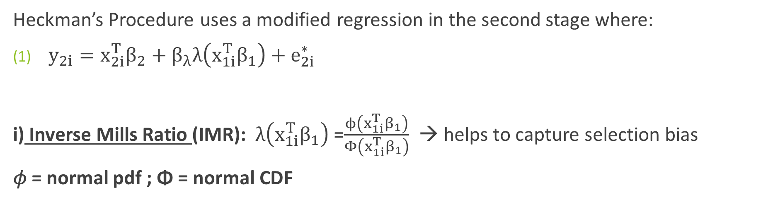
Heckman Correction - Specifics
Heckman’s Procedure uses a modified regression in the second stage where:
$y_{2i}=x_{2i}^{T}β_{2}+β_{λ}λ\left(x_{1i}^{T}β_{1}\right)+e_{2i }^{∗}$
i) Inverse Mills Ratio (IMR): $λ\left(x_{1i}^{T}β_{1}\right)$ =$\frac{ϕ\left(x_{1i}^{T}β_{1}\right)}{Φ\left(x_{1i}^{T}β_{1}\right)}$ → helps to capture selection bias
𝜙 = normal pdf ; Φ = normal CDF

Slide 18
Heckman Correction for Selection Bias
Heckman’s model is computationally simple, however it has drawbacks:
Assumes bivariate normal distribution – subject to bias if the data generating process is not normal (or approximately)
Sensitive to extreme values
Utilized for selection bias for truncation
If variables in 1st and 2nd stage are the same, then IMR is only identified with non-linear IMR; generally require at least 1 variables in 2nd stage that is not in the first stage

Slide 19
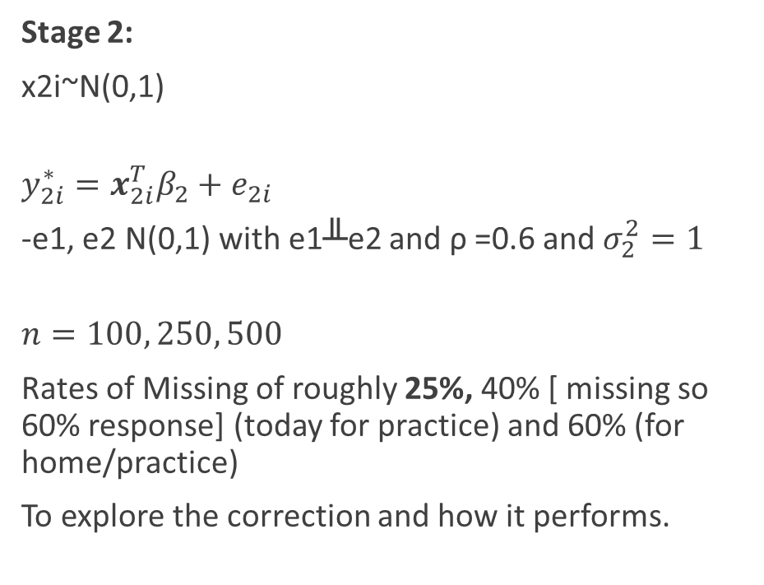
Methods – Simulation Set up – As Before with Further Info
We use population with N=10000.
Use the Heckman model described above:
Stage 1:
x1i~N(0,1)
y1i* = x1i +e1i
Stage 2:
x2i~N(0,1)
$$y_{2i}^{∗}=x_{2i}^{T}β_{2}+e_{2i}$$
-e1, e2 N(0,1) with e1╨e2 and ρ =0.6 and $σ_{2}^{2}=1$
$$n=100, 250, 500$$
Rates of Missing of roughly 25%, 40% [ missing so 60% response] (today for practice) and 60% (for home/practice)
To explore the correction and how it performs.

Slide 20
Using Sample Size = 100, 250, 500 – 25% Missing
Regression Results - Overall
What do we notice?
If we don’t adjust things, at each of the sample sizes with this level of missing (due to selection bias) the estimates are biased and the SE are not efficient!
 | Pop Value |  | Sample 100 |  | Sample 250 |  | Sample 500
Var | Est (SE) | P-value | Est (SE) | P-value | Est (SE) | P-value | Est (SE) | P-value
Constant | 18.00 (0.046) | <0.0001 | 18.31 (0.598) | <0.0001 | 18.19 (0.338) | <0.0001 | -18.25 (0.242) | <0.0001
Educ | -0.15 (0.002) | <0.0001 | -0.16 (0.026) | <0.0001 | -0.138 (0.015) | <0.0001 | -0.147 (0.011) | <0.0001
Age | 0.35 (0.0007) | <0.0001 | 0.338 (0.012) | <0.0001 | 0.338 (0.0073) | <0.0001 | 0.339 (0.005) | <0.0001

Slide 21
Using Sample Size = 100, 250, 500 – 25% Missing
Regression Results – Overall
Note: IMR < 0.05 in all cases – confirming selection bias due to truncation
What do we notice?
Now look at our estimates and SE as n increases
 | Pop Value | Sample 100 |  | Sample 250 |  | Sample 500
Var | Est (SE) | Est (SE) | Corrected | Est (SE) | Corrected | Est (SE) | Corrected
Constant | 18.00 (0.046) | 18.31 (0.598) | 17.90 (0.60) | 18.19 (0.338) | 17.93 (0.34) | 18.25 (0.242) | 18.08 (0.248)
Educ | -0.15 (0.002) | -0.16 (0.026) | -0.167 (0.025) | -0.138 (0.015) | -0.142 (0.014) | -0.147 (0.011) | -0.149 (0.011)
Age | 0.35 (0.0007) | 0.338 (0.012) | 0.336 (0.013) | 0.338 (0.0073) | 0.35 (0.008) | 0.339 (0.005) | 0.345 (0.005)

Slide 22
Heckman By Hand and With SampleSelection
Doing the Heckman Manually in R Looks Like:
#sample size 100
# Run the Probit
probit = glm(indicator ~ educ + age, data = samp100, family = binomial(link = 'probit’))
summary(probit)
# Create the IVMR Using Probit Values
samp100$probit_lp =predict(probit)
samp100$mills100=dnorm(samp100$probit_lp)/pnorm(samp100$probit_lp)
summary(samp100$mills100)
samp100$imr =samp100$mills100ggplot2::qplot(samp100$imr, geom = 'histogram’)
# Running the LM with the IMR included to Adjust the Model
lm_HM_select = lm(BMI ~ educ + age + imr, data = samp100)
summary(lm_HM_select)

Slide 23
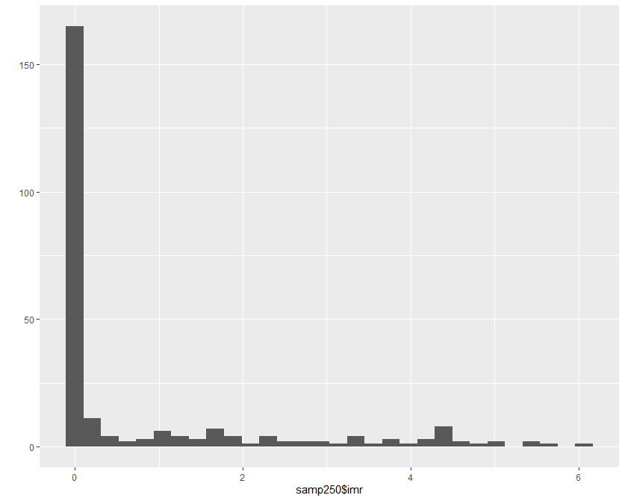
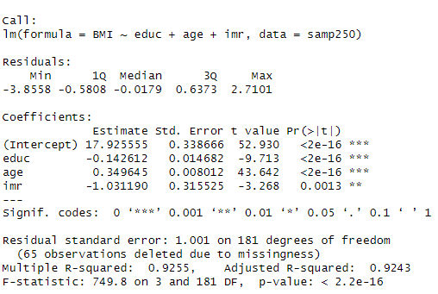
Heckman By Hand and With SampleSelection
Histogram and Regression Results
If the was no large IMR values (ie IMR p-value > 0.05) this would be indication that you don’t have selection bias

Slide 24
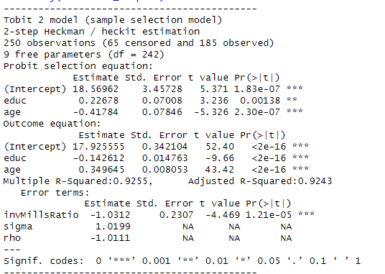
Heckman By Hand and With SampleSelection
Doing the Heckman with Sample Selection
library(sampleSelection)
selection_samp250 = selection(indicator ~ educ + age , BMI ~ educ + age, method = '2step', data=samp250)
summary(selection_samp250)

Slide 25
Thinking of Heckman Set up As Missing Data
The Heckman Model is essentially a missing data problem (i.e. what you don’t observe)
The missingness is related to the outcome and the covariates; so we formally call this non-ignorable missing.
Q: So can we use missing data methods to also consider a solution?
Answer: Yes!

Slide 26
Types of Missing Data
Missing Completely at Random (MCAR):
-highest level of randomness
-the probability of having a missing value does not depend on either the known values or the missing data.
-note that P(R|Y) = P(R); missingness is completely unsystematic.
Missing at Random (MAR):
-probability of having a missing value may depend on the known values, but not on the value of the missing data itself.
-we may write P (R|Y) = P (R|Y_{obs}).
Not Missing at Random (NMAR): This is what we have!
-the probability of having a missing value could depend on the value of that attribute.
-P (R|Y) ≠ P (R|Y_{obs}) or P (R|Y) = P (R|Y_{obs},Y_{miss})

Slide 27
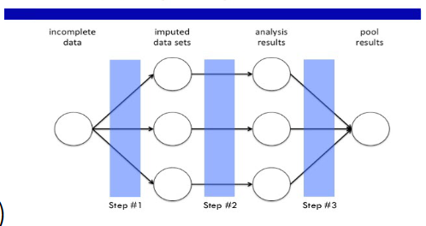
Multiple Imputation
A mechanism that utilizes multiple imputations to arrive at a final imputation; normally M=5 to 10.
Two phases – imputation (phase1) and pooling phase (phase2)
-can use the multiple datasets to create an imputation and inference about the imputation
Limitations:
-can be computationally intensive and in some cases impractical to use.
-if uses a parametric model it still suffers from model misspecification

Slide 28
Multiple Imputation Model in R
What if we use MI in R to get estimates and then compare to our model results?
Use MICE package – the default is PMM = predictive mean matching
We simply need to note the number of imputations (M=5; however you can change this) and make sure to pool the results.

Slide 29
Using Sample Size = 100, 250, 500 – 25% Missing
Regression Results – Overall
Note: IMR < 0.05 in all cases – confirming selection bias due to truncation
What do we notice?
How does MI perform?
Can we draw any general conclusions?
Note: Consider what is missing and the assumptions about Heckman along with our simulated data
 | Pop Value | Sample 100 |  |  | Sample 250 |  |  | Sample 500
Var | Est (SE) | Est (SE) | Corrected | Imputed | Est (SE) | Corrected | Imputed | Est (SE) | Corrected | Imputed
Constant | 18.00 (0.046) | 18.31 (0.598) | 17.90 (0.60) | 18.31 (0.60) | 18.19 (0.338) | 17.93 (0.34) | 18.20 (0.338) | 18.25 (0.242) | 18.08 (0.248) | 18.25 (0.242)
Educ | -0.15 (0.002) | -0.16 (0.026) | -0.167 (0.025) | -0.16 (0.026) | -0.138 (0.015) | -0.142 (0.014) | -0.138 (0.015) | -0.147 (0.011) | -0.149 (0.011) | -0.147 (0.011)
Age | 0.35 (0.0007) | 0.338 (0.012) | 0.336 (0.013) | 0.338 (0.012) | 0.338 (0.0073) | 0.35 (0.008) | 0.338 (0.0073) | 0.339 (0.005) | 0.345 (0.005) | 0.339 (0.005)

Slide 30
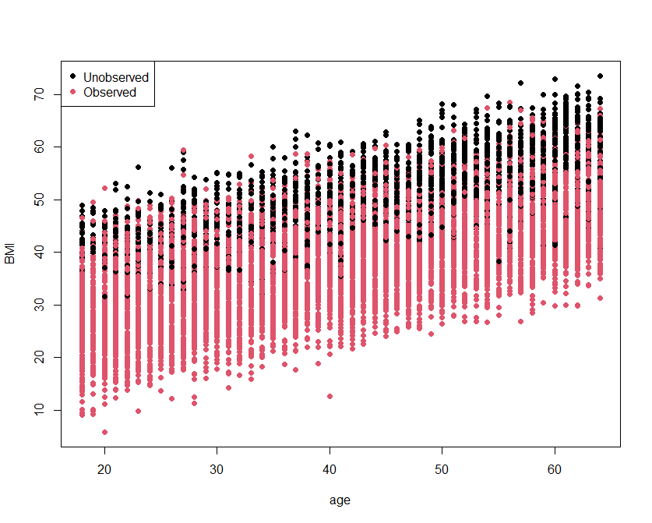
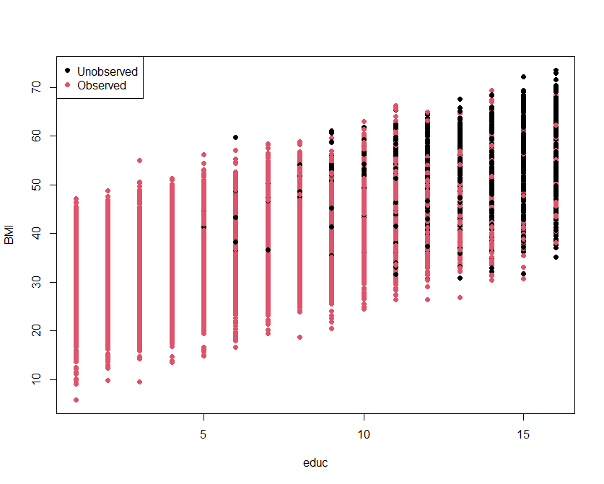
Population Plots – Observed vs Unobserved (25%)

Slide 31
Famous Application of the Heckman Model
(1)Winship and Mare (1992) - Models for sample selection bias (citations 781); examines labor market data in the presence of selection bias.
(2) Collier and Mahoney (1996) -Insights and pitfalls: Selection bias in qualitative research (cited 681 times); examines international political science data
(3) Bushway et al. (2007) - Is the magic still there? The use of the Heckman two-step correction for selection bias in criminology (cited 387 times)

Slide 32
Summary - Critical factors and methodological pitfalls to avoid
The regression analyses of the first and second stages should contain the same independent and control variables – do not forget time fixed-effects for panel data
The regression types used in the two stages are essential for the Heckman two-stage estimation since the error terms of both stages should follow a bivariate normal distribution
  The first stage must be a probit regression
  The second stage should be either a probit or an OLS regression, and “since the derivation of the Heckman two-step method relies on the normality of errors, we are hesitant to suggest that the use of other estimation techniques is appropriate” (Wolfolds & Siegel, 2019, p. 452)
The Heckman two-stage estimation is not suitable for count data as it requires a full parametric speciﬁcity
→ regression error speciﬁcation test (RESET) by Ramsey (1969) to indicate whether the normality assumption can be found in the error terms

Slide 33
Let’s Practice
Let’s do one the simulated dataset → let’s consider higher rates of missing
Step 1 – Import the Data
Use: samp100.60; samp250.60; samp500.60
library(readxl)
dataname=read_excel(‘C:/Director/samp.100.60.xlsx', sheet=“sheet1")
Step 2 – Use the sample selection package
Indicator, educ, age, BMI
library(sampleSelection)
selection_samp250 = selection(indicator ~ educ + age , BMI ~ educ + age, method = '2step', data=samp250)
summary(selection_samp250)

Slide 34
Let’s Practice
Let’s consider some real-world data – NHANES
library(sas7bdat) # install if you don’t have it
Read in the SAS dataNHdata <- read.sas7bdat("C:/Users/Michael/Desktop/Final Code & Paper/NHANES/merged3.sas7bdat")
*change to your directory
avgdrinks ~ age + gender + race + currentwt [ we suspect people might not report high levels of drinking]
**Create a indicator for avg drinks → if missing try something like
NHdata$missdrink=ifelse(NHdata$avgdrinks =="NaN", 0, 1)

Slide 35
Recommended literature
Further literature recommendations addressing the Heckman two-stage estimation and MI:
Certo, S. T., Busenbark, J. R., Woo, H.-S., & Semadeni, M. 2016. Sample selection bias and Heckman models in strategic management research. Strategic Management Journal, 37: 2639-2657.
Bushway, S., Johnson, B. D., & Slocum, L. A. 2007. Is the magic still there? The use of the Heckman two-step correction for selection bias in criminology. Journal of Quantitative Criminology, 23: 151-178.
Heckman, J. J. 1979. Sample selection bias as a specification error. Econometrica, 47: 153-161.
Wolfolds, S. E., & Siegel, J. 2019. Misaccounting for endogeneity: The peril of relying on the Heckman two-step method without a valid instrument. Strategic Management Journal, 40: 432-462.
Bendig, D., Hoke, J. (2022). Correcting Selection Bias in Innovation and Entrepreneurship Research: A Practical Guide to Applying the Heckman Two-Stage Estimation. Discussion Paper. Available at: https://www.statisticslab.org/
https://m-clark.github.io/models-by-example/heckman-selection.html
Koné, S., Bonfoh, B., Dao, D. et al. Heckman-type selection models to obtain unbiased estimates with missing measures outcome: theoretical considerations and an application to missing birth weight data. BMC Med Res Methodol 19, 231 (2019). https://doi.org/10.1186/s12874-019-0840-7
Galimard JE, Chevret S, Curis E, Resche-Rigon M. Heckman imputation models for binary or continuous MNAR outcomes and MAR predictors. BMC Med Res Methodol. 2018 Aug 31;18(1):90. doi: 10.1186/s12874-018-0547-1. PMID: 30170561; PMCID: PMC6119269.

Slide 36
Further References
Arregle, J. L., Naldi, L., Nordqvist, M., & Hitt, M. A. (2012). Internationalization of family-controlled firms: A study of the effects of external involvement in governance. Entrepreneurship Theory and Practice, 36(6), 1115-1143. https://doi.org/10.1111/j.1540-6520.2012.00541.x
Bushway, S., Johnson, B. D., & Slocum, L. A. (2007). Is the magic still there? The use of the Heckman two-step correction for selection bias in criminology. Journal of Quantitative Criminology, 23(2), 151-178. https://doi.org/10.1007/s10940-007-
9024-4
Cameron, A. C., & Trivedi, P. K. (2010). Microeconometrics using Stata (Vol. 2). College Station, TX: Stata press.
Certo, S. T., Busenbark, J. R., Woo, H.-S., & Semadeni, M. (2016). Sample selection bias and Heckman models in strategic management research. Strategic Management Journal, 37(13), 2639-2657. https://doi.org/10.1002/smj.2475
Clougherty, J. A., Duso, T., & Muck, J. (2015). Correcting for self-selection based endogeneity in management research. Organizational Research Methods, 19(2), 286-347. https://doi.org/10.1177/1094428115619013
Greene, W. H. (2018). Econometric analysis (8th ed.). Pearson.
Hamilton, B. H., & Nickerson, J. A. (2003). Correcting for endogeneity in strategic management research. Strategic Organization, 1(1), 51-78. https://doi.org/10.1177/1476127003001001218
Heckman, J. J. (1979). Sample selection bias as a specification error. Econometrica, 47(1), 153-161. https://doi.org/10.2307/1912352
Heckman, J. J. (2018). Selection bias and self-selection. In S. N. Durlauf & L. E. Blume (Eds.), The new palgrave dictionary of economics (pp. 12130-12147). Palgrave Macmillan. https://doi.org/10.1057/978-1-349-95121-5_1762-2
Hill, A. D., Johnson, S. G., Greco, L. M., O’Boyle, E. H., & Walter, S. L. (2021). Endogeneity: A review and agenda for the methodology-practice divide affecting micro and macro research. Journal of Management, 47(1), 105-143. https://doi.org/10.1177/0149206320960533
Hill, R. C., Adkins, L. C., & Bender, K. A. (2003). Test statistics and critical values in selectivity models. In T. B. Fomby & R. Carter Hill (Eds.), Maximum likelihood estimation of misspecified models: Twenty years later (17th ed., pp. 75-105).
Emerald Group Publishing. https://doi.org/10.1016/S0731-9053(03)17004-1
Ramsey, J. B. (1969). Tests for specification errors in classical linear least-squares regression analysis. Journal of the Royal Statistical Society: Series B (Methodological), 31(2), 350-371. https://doi.org/10.1111/j.2517-6161.1969. tb00796.x
Ullah, S., Zaefarian, G., & Ullah, F. (2021). How to use instrumental variables in addressing endogeneity? A step-by-step procedure for non-specialists. Industrial Marketing Management, 96, A1-A6. https://doi.org/10.1016/j.indmarman.2020.03.006
Wolfolds, S. E., & Siegel, J. (2019). Misaccounting for endogeneity: The peril of relying on the Heckman two-step method without a valid instrument. Strategic Management Journal, 40(3), 432-462. https://doi.org/10.1002/smj.2995

