Slide 1
Introduction to Complex Survey Data Analysis
Sixia Chen, PhD
OSCTR Novel Methodological Unit Short Course
4/7/2023

Slide 2
Course Material
https://osctr.ouhsc.edu/short-course

Slide 3
Outline
Introduction to Complex Survey Data
SAS code templates
Searching design information for real data analysis
Examples with hands-on practice
Q&A

Slide 4
Types of survey data
Probability sample: Each unit in the population has non-zero probability of being selected in the sample
Non-probability sample (Convenience sample): Not every unit in the population has non-zero probability of being selected in the sample

Slide 5
Probability sample VS Non-probability sample
Measure\Type of Survey | Prob | Non-Prob
Selection Bias | Small | Large
Representativeness | High | Low
Cost | High | Low
Time | Long | Short
Lack of Frame Survey | Impossible | Possible

Slide 6
Complex Survey Data
Data collected by using complex sampling designs (Prob or Non-Prob)
Commonly used probability sampling designs
  Simple random sampling with/without replacement
  Stratified sampling
  Multi-stage sampling design
  Probability proportional to size sampling design
  Two-Phase sampling
  Multi-Frame sampling design

Slide 7
Probability Sample -NHANES
Four year National Health and Nutrition Examination Survey (NHANES): stratified multi-stage complex sampling design
Sample design:
  Draw stratified systematic PPS sample of 60 counties from US
  Within each selected county, draw independent segment sample by using stratified systematic PPS
  Within each selected segment, draw systematic sample of households
  Within each selected household, draw people randomly
  Oversampling of certain groups such as older people, Asians and so on
NHANES has clustering, stratification, PPSWOR and oversampling

Slide 8
Probability Sample - BRFSS
The Behavioral Risk Factor Surveillance System (BRFSS) is the nation’s premier system of health-related telephone surveys that collect state data about U.S. residents regarding their health-related risk behaviors, chronic health conditions, and use of preventive services
BRFSS is one stage stratified random digit dialing telephone survey
Independent sampling for each of the 50 states in US
BRFSS divides telephone numbers into two groups, or strata, which are sampled separately. The high-density and medium-density strata contain telephone numbers that are expected to belong mostly to households

Slide 9
Non-Probability Sample - Example
2019 Tribal Behavioral Risk Factor Surveillance System conducted by Tribal Epidemiology Center
Target population: American Indian Adults who lived in OK, KS, TX
Sampling design:
  Tribal event sampling
  Email sampling
  Social media sampling
Sample size improved from about 300 in 2015 to about 800 in 2019

Slide 10
Weighting Complexity - Reasons
Design complexity
Nonresponse complexity: unit nonresponse and item nonresponse
Decreasing MSE: ratio estimation (calibration) and trimming
Variance estimation complexity
Statistical disclosure control complexity

Slide 11
Weighting Complexity - Components
Design base weight
Nonresponse adjustment
Imputation
Ratio estimation (raking or calibration)
Trimming
Variance estimation
Statistical disclosure control

Slide 12
Sampling weights
General formula
FW=BW×NRA×CA×TRA
where each term is defined as following:
FW: final sampling weight
BW: design base weight
NRA: nonresponse adjustment factor
CA: calibration (ratio or raking) adjustment factor
TRA: trimming adjusted factor

Slide 13
Design features for Statistical Analysis
Final sampling weight
First Stage Stratification (Stratum or Pseudo Stratum)
First Stage Clustering (Primary Sampling Unit (PSU) or Pseudo PSU)
Replication weights (Optional, For variance estimation purpose)

Slide 14
SAS code – Descriptive Statistics for Continuous Variables
proc surveymeans data=indat;
var var1 var2 var3;
weight finalwt; /*final sampling weight*/
domain var4; /*subgroup analysis*/
strata st; /*Stratification variable*/
cluster psu; /*Clustering variable*/
run;

Slide 15
SAS code – Descriptive Statistics for Categorical Variables
proc surveyfreq data=indat; /*input data file*/
tables var1 var2 var3;
weight finalwt; /*final sampling weight*/
domain var4; /*subgroup analysis*/
strata st; /*Stratification variable*/
cluster psu; /*Clustering variable*/
run;

Slide 16
SAS code – Binary Association Analysis for Continuous Dependent Variable
proc surveyreg data=indat;
class var2; /*If var2 is categorical variable*/
model var1=var2; /*var1 is dep var, var2 is indep var*/
weight finalwt; /*final sampling weight*/
strata st; /*Stratification variable*/
cluster psu; /*Clustering variable*/
run;
/*Note that two sample t test can be done by using dummy variable (1/0) for var2*/

Slide 17
SAS code – Binary Association Analysis for Categorial Variables
proc surveyfreq data=indat; /*input data file*/
tables var1*(var2 var3) /row CL chisq;
weight finalwt; /*final sampling weight*/
domain var4; /*subgroup analysis*/
strata st; /*Stratification variable*/
cluster psu; /*Clustering variable*/
run;
/*Need to use Rao-Scott Chi-square test instead of traditional Chi-square test*/

Slide 18
SAS code – Multivariate logistic regression
proc surveylogistic data=indat;
class var1 var2 var3; /*specify categorical variables*/
model var1=var2 var3 var4; /*var1 is dep var, others are indep vars*/
weight finalwt; /*final sampling weight*/
strata st; /*Stratification variable*/
cluster psu; /*Clustering variable*/
run;

Slide 19
SAS code – Multivariate linear regression
proc surveyreg data=indat;
class var1 var2 var3; /*specify categorical variables*/
model var1=var2 var3 var4; /*var1 is dep var, others are indep vars*/
weight finalwt; /*final sampling weight*/
strata st; /*Stratification variable*/
cluster psu; /*Clustering variable*/
run;

Slide 20
SAS code – Cox regression
proc surveyphreg data=indat;
class var1 var2 var3; /*specify categorical variables*/
model mortality*death(0)=var1 var2 var3 var4; /*mortality is survival time, death is censoring indicator, others are predictors*/
weight finalwt; /*final sampling weight*/
strata st; /*Stratification variable*/
cluster psu; /*Clustering variable*/
run;

Slide 21
Model selection
SAS macro for backward, forward, and stepwise model selection: https://www.norc.org/PDFs/CESR%20Docs/MWSUG-2011-SA02.pdf
Manual backward model selection

Slide 22
Searching design information for data analysis
National Health and Nutrition Examination Survey (NHANES)
The Behavioral Risk Factor Surveillance System (BRFSS)
National Health Interview Survey (NHIS)

Slide 23
Example – NHANES
2017-2018 NHANES data: https://wwwn.cdc.gov/nchs/nhanes/continuousnhanes/default.aspx?BeginYear=2017
We consider the following data files:
  Demographics data (Age, Gender, Race, etc.)
  Examination data (Blood pressure, Body measure)
  Laboratory Data (Total Cholesterol)
Design features: Final weight, Stratification, and Clustering

Slide 24
Research Question and Variables
RQ: What is the association between Total Cholesterol and other predictors?
Dependent variable: Total Cholesterol
Predictors: Age, Gender, Race, Education, Income, Household Size, Marital Status, BMI, Blood Pressure (Diastolic and Systolic)
Design variables: final weight, stratification variable, clustering variable
Removed all the missing values

Slide 25
Unweighted Descriptive Statistics
proc means nmiss min P50 mean max std maxdec=2 data=comb2;
var BMXBMI BPXDI1 BPXSY1 RIDAGEYR;
run;
proc freq data=comb2;
tables DMDEDUC2 DMDHHSIZ DMDMARTL INDHHIN2 RIAGENDR RIDRETH1 /missing list;
run;

Slide 26
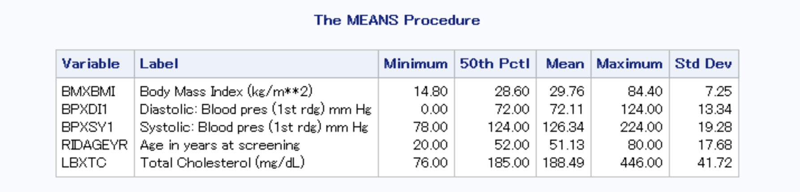
Unweighted Descriptive Statistics (2)

Slide 27
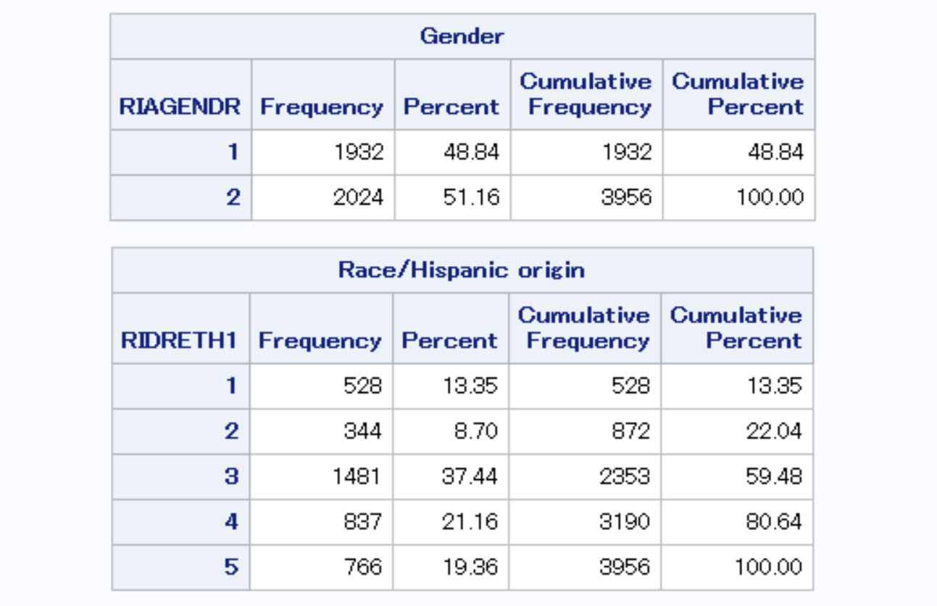
Unweighted Descriptive Statistics (3)

Slide 28
Weighted Descriptive analysis
proc surveymeans nmiss mean sum median std data=comb2;
var BMXBMI BPXDI1 BPXSY1 RIDAGEYR LBXTC;
weight WTMEC2YR;
strata SDMVSTRA;
cluster SDMVPSU;
run;

Slide 29
Weighted Descriptive analysis (2)
proc surveyfreq data=comb2;
tables DMDEDUC2 DMDHHSIZ DMDMARTL INDHHIN2 RIAGENDR RIDRETH1;
weight WTMEC2YR;
strata SDMVSTRA;
cluster SDMVPSU;
run;

Slide 30
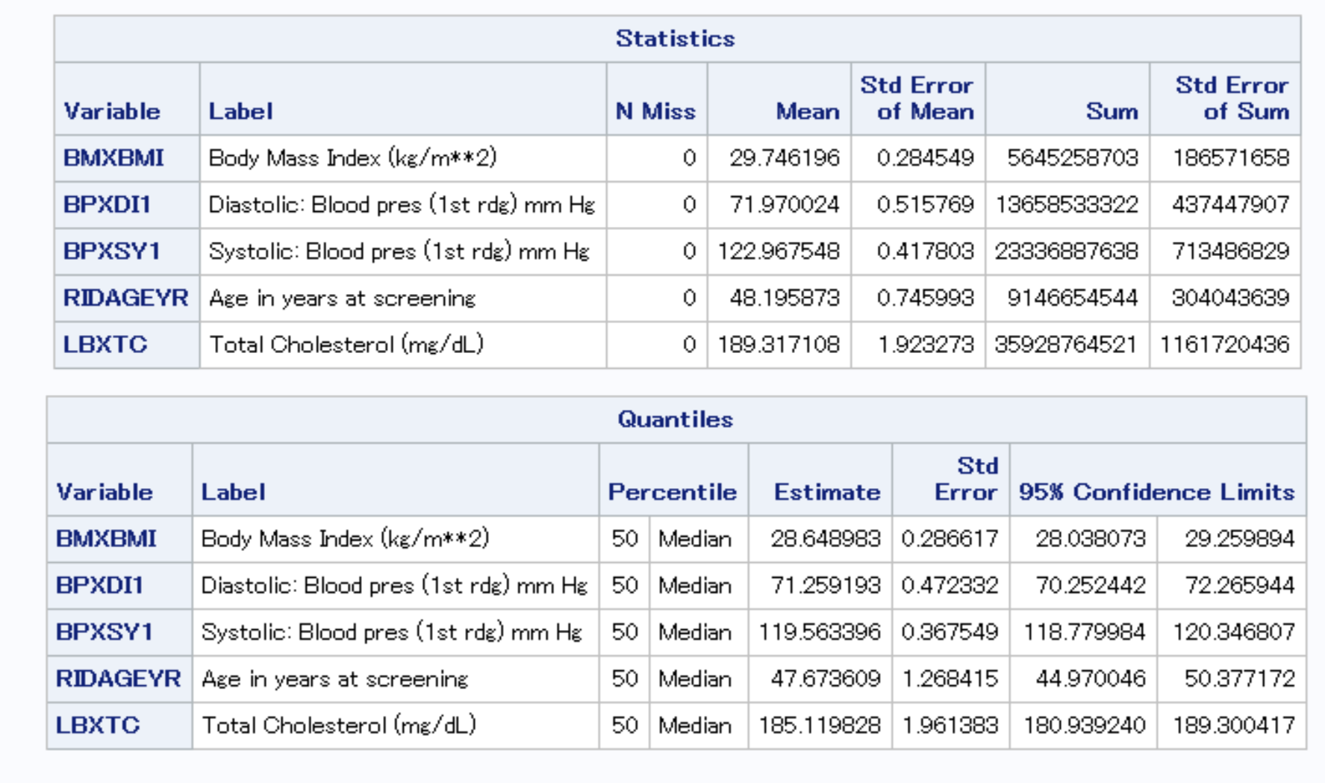
Weighted Descriptive analysis (3)

Slide 31
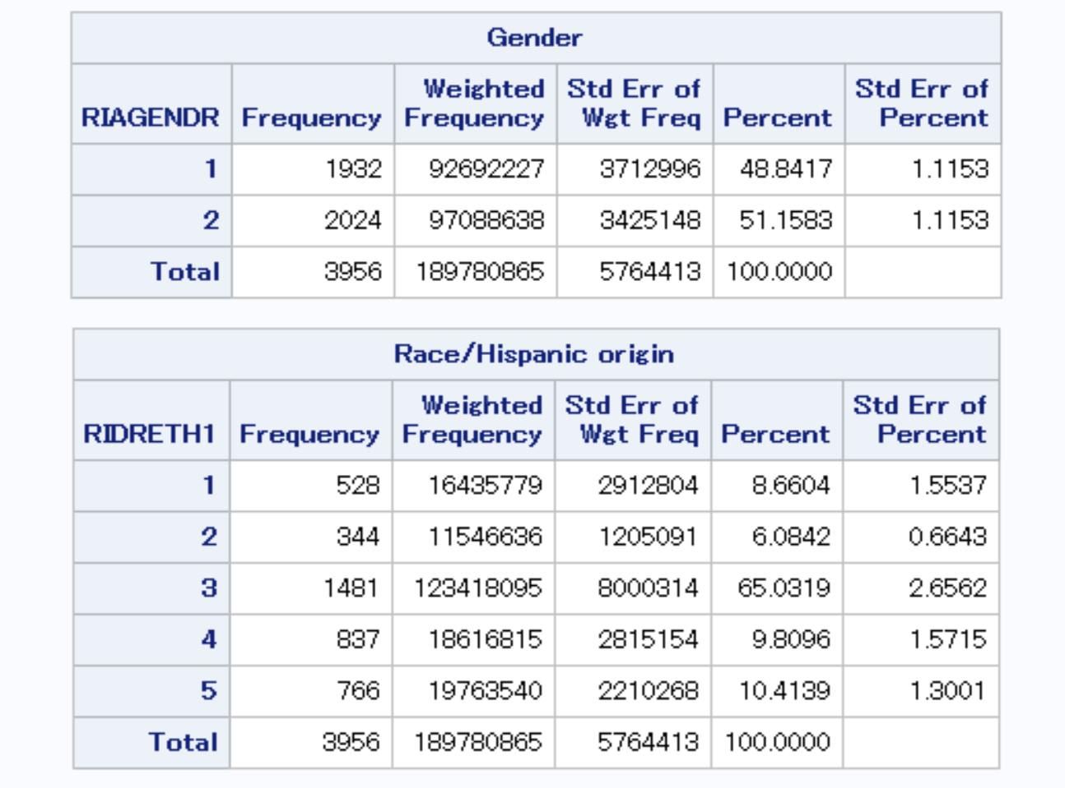
Weighted Descriptive analysis (4)

Slide 32
Binary Association Analysis
proc surveyreg data=comb2;
model LBXTC=BMXBMI;
weight WTMEC2YR;
strata SDMVSTRA;
cluster SDMVPSU;
run;

Slide 33
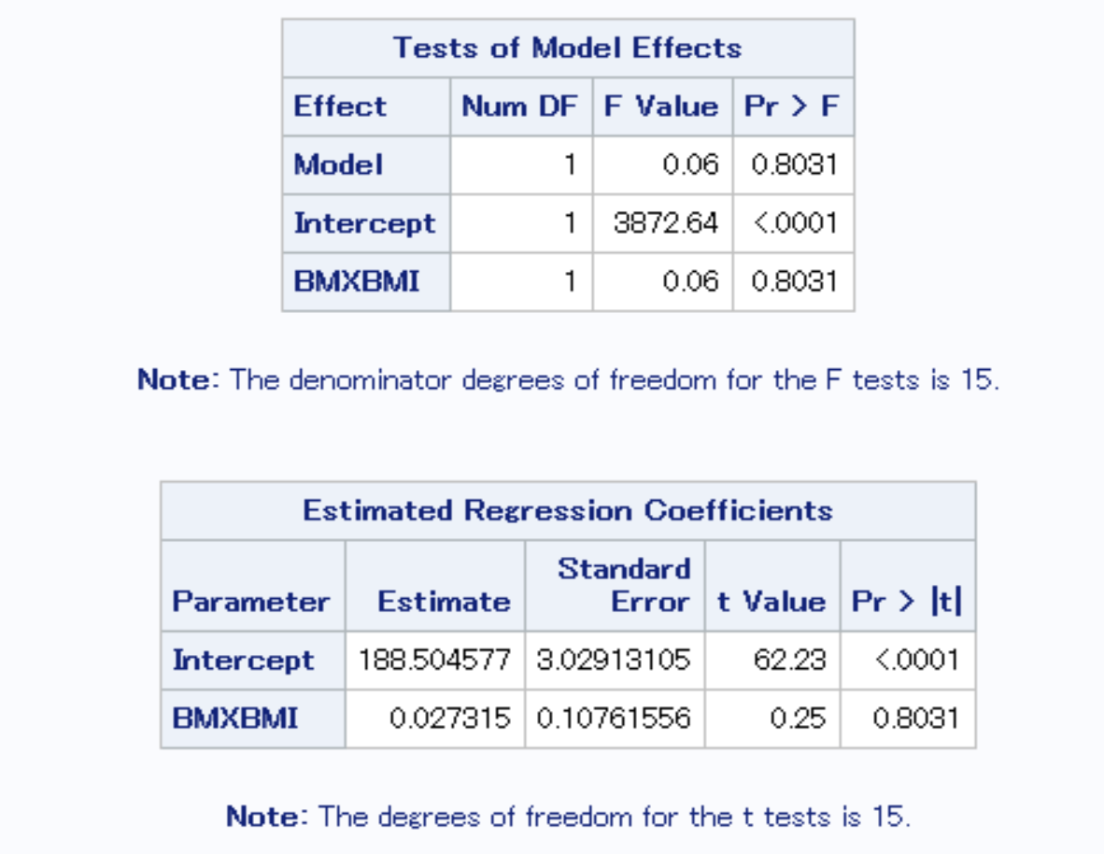
Binary Association Analysis (2)

Slide 34
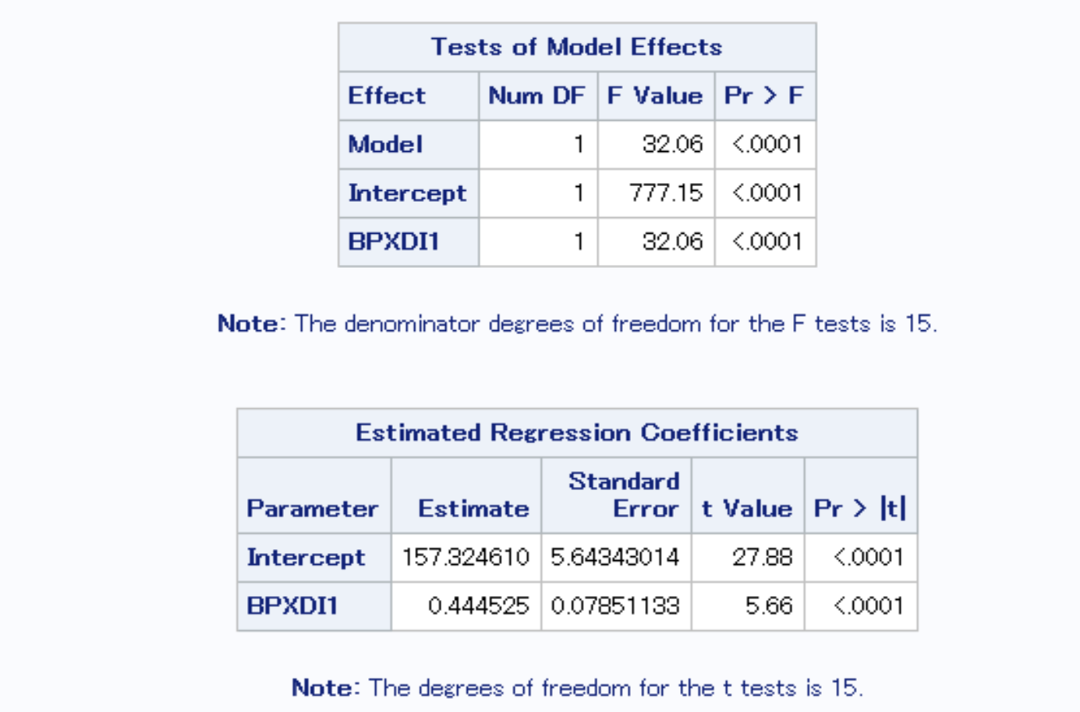
Binary Association Analysis (3)

Slide 35
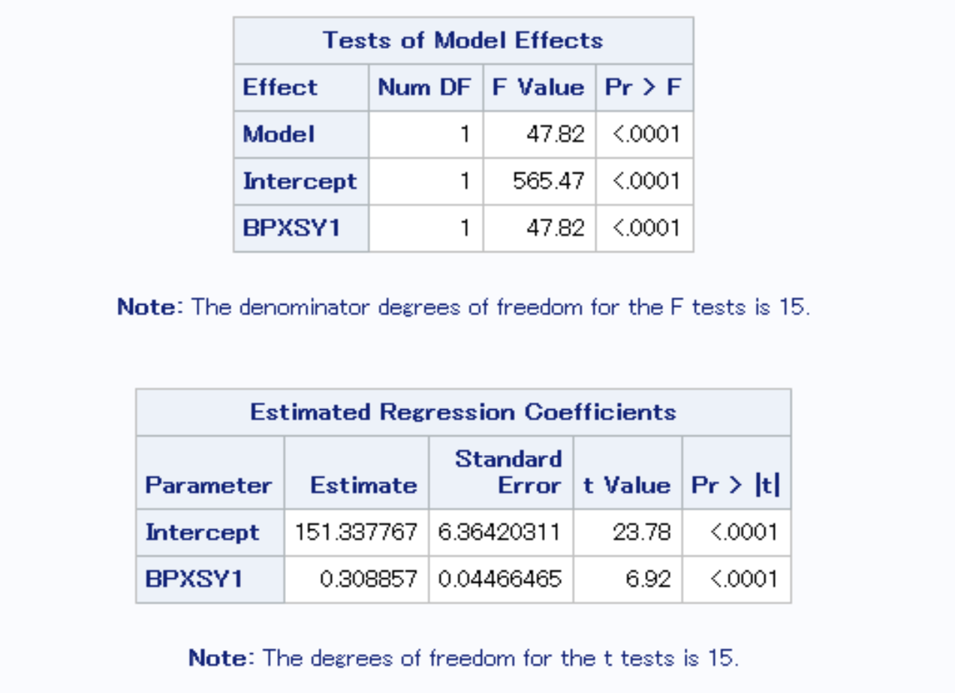
Binary Association Analysis (4)

Slide 36
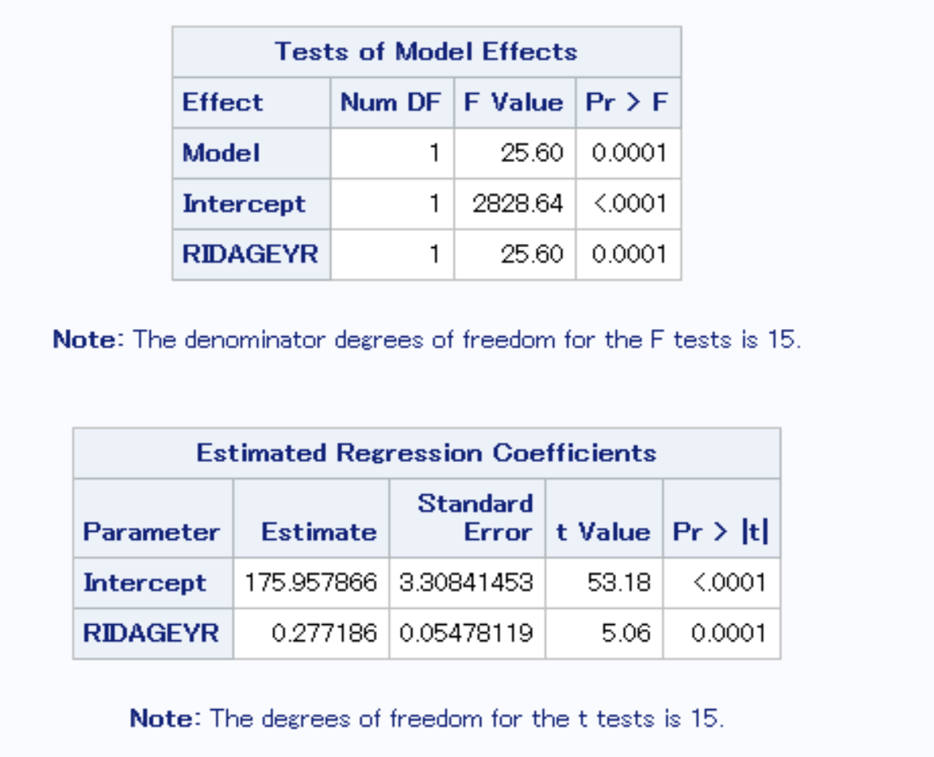
Binary Association Analysis (5)

Slide 37
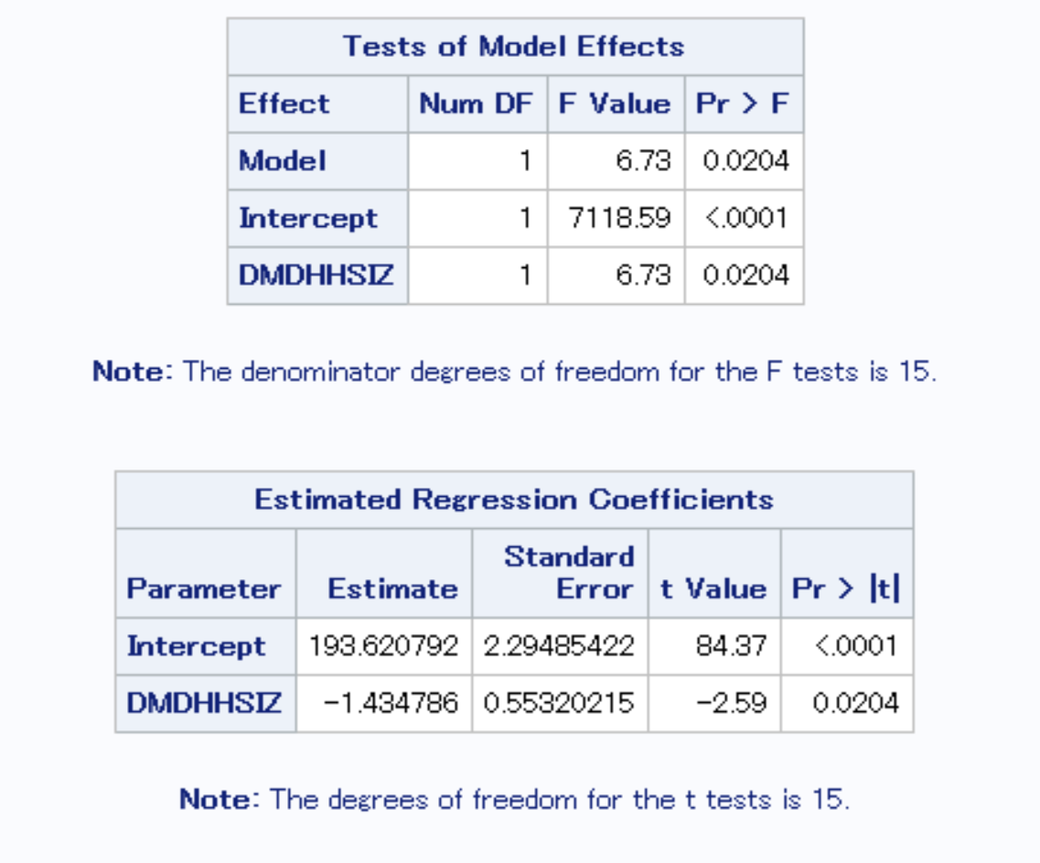
Binary Association Analysis (6)

Slide 38
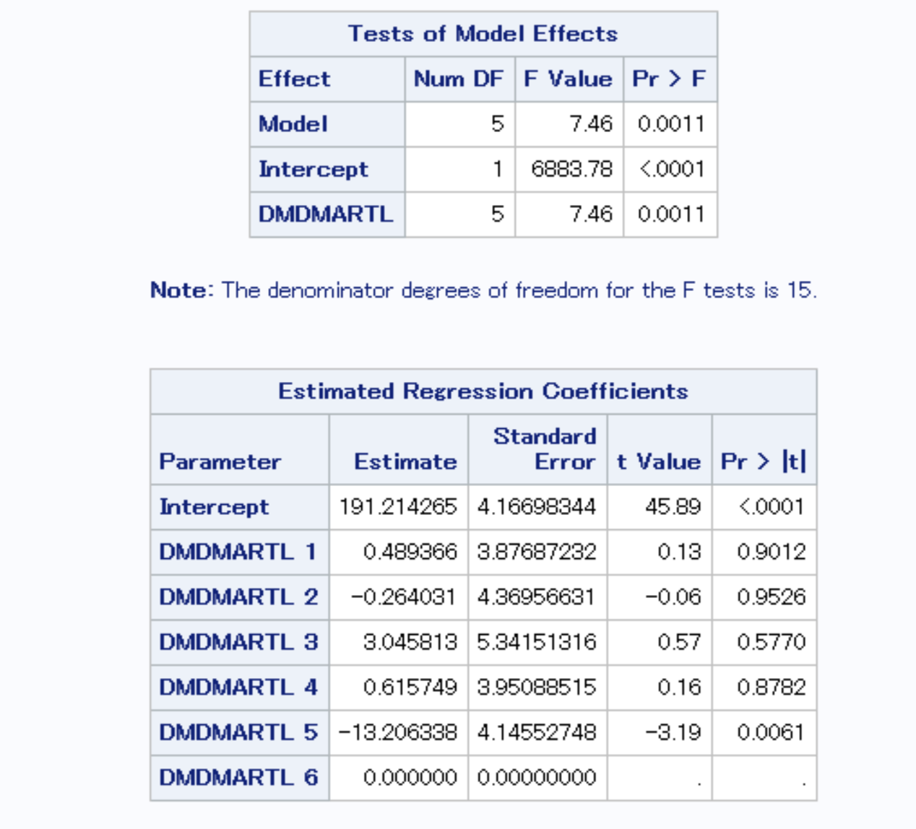
Binary Association Analysis (7)

Slide 39
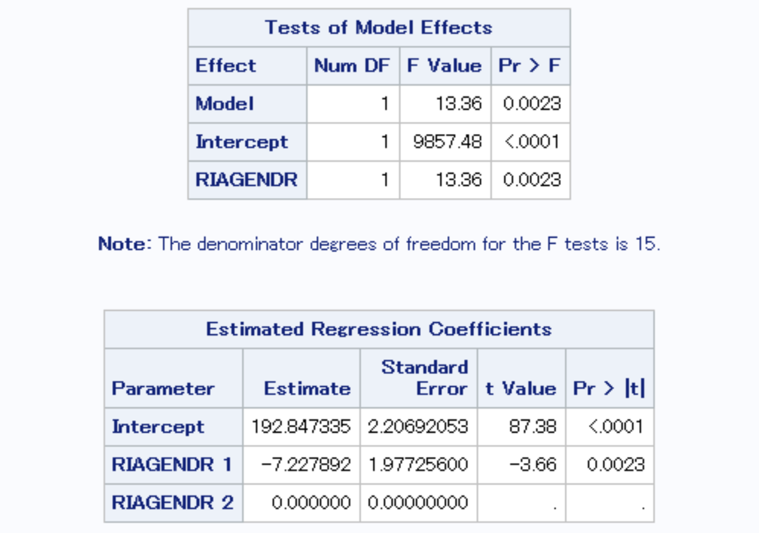
Binary Association Analysis (8)

Slide 40
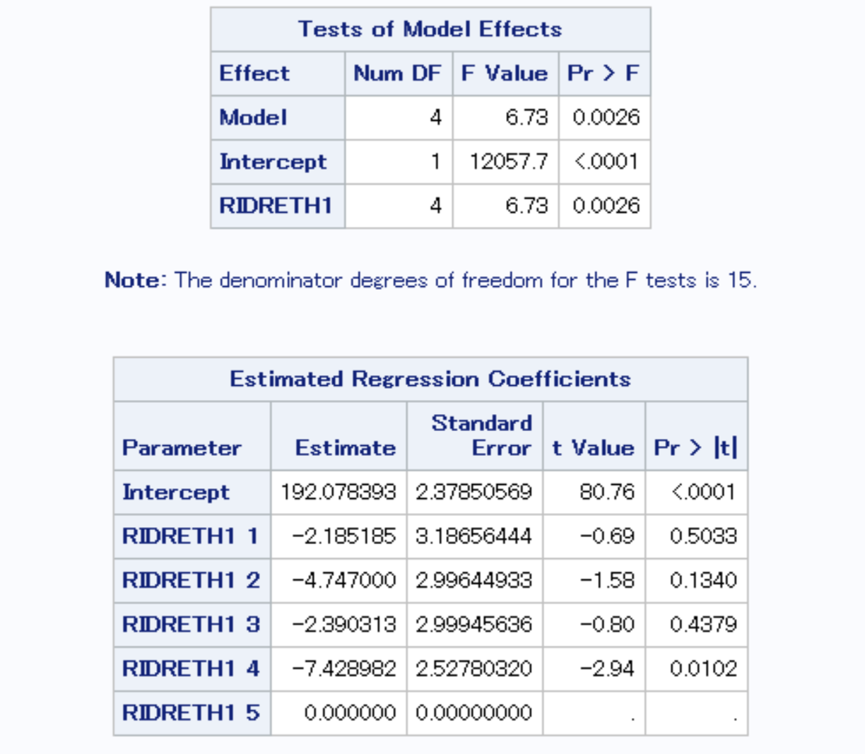
Binary Association Analysis (9)

Slide 41
Binary Association Analysis (10)
proc surveyfreq data=comb2;
tables LBXTC2*(DMDEDUC2 DMDHHSIZ DMDMARTL RIAGENDR RIDRETH1) /row CL chisq;
weight WTMEC2YR;
strata SDMVSTRA;
cluster SDMVPSU;
run;
/*Note that LBXTC2=0 if LBXTC2<188 and 1 otherwise*/

Slide 42
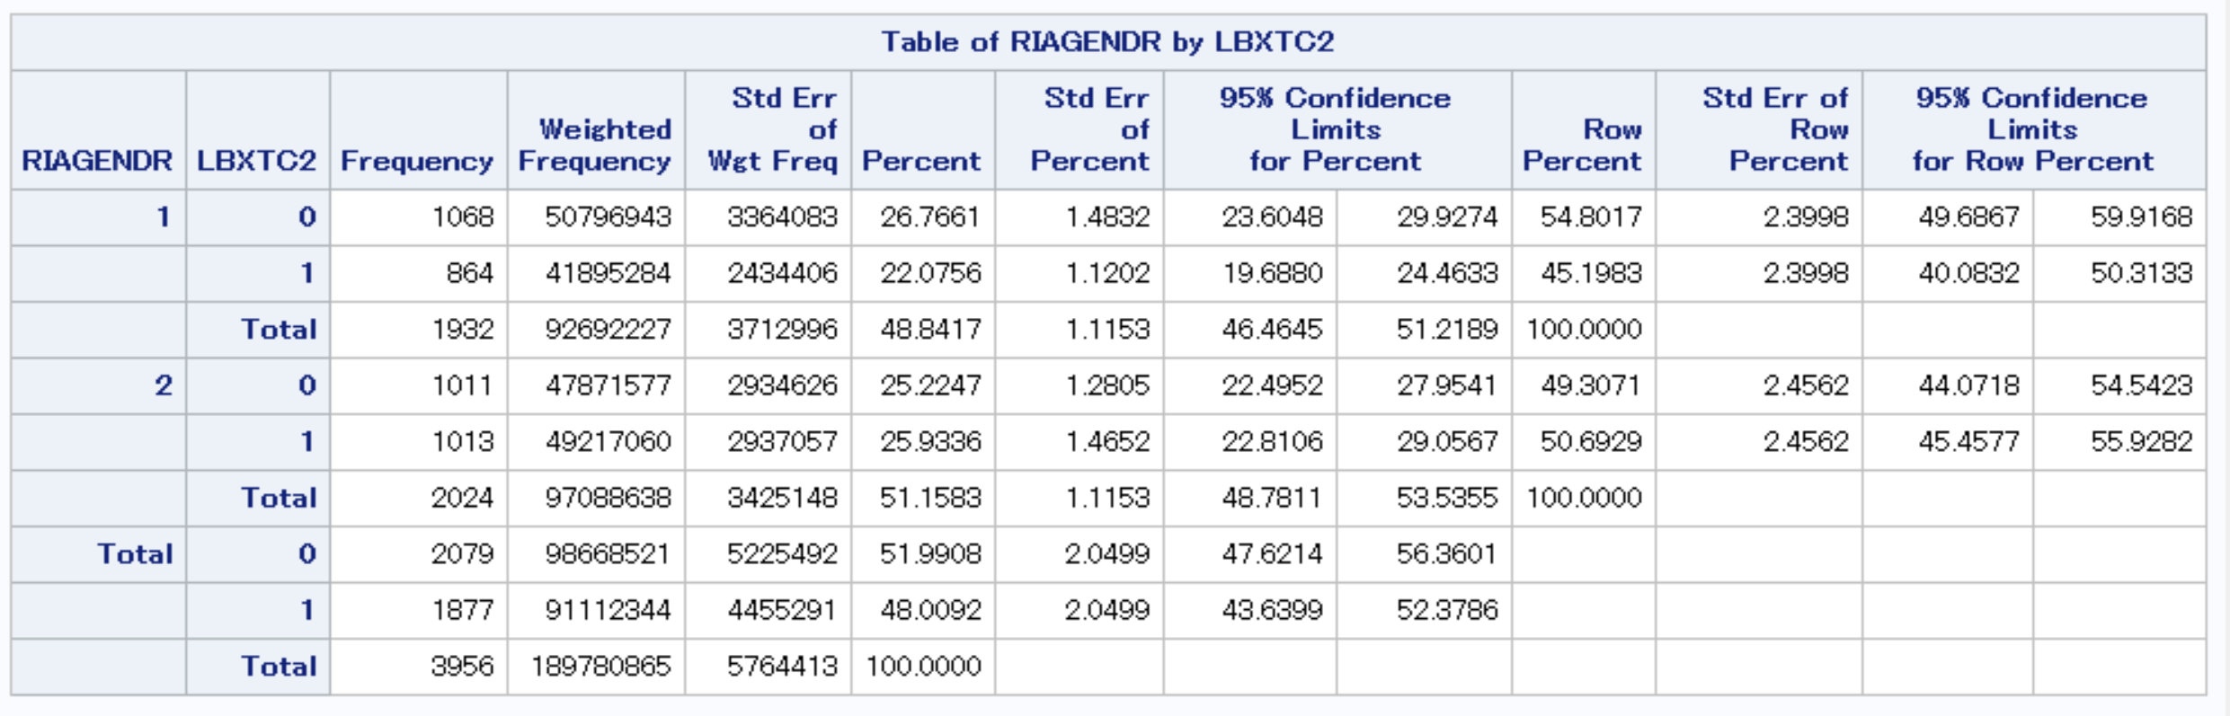
Binary Association Analysis (11)

Slide 43
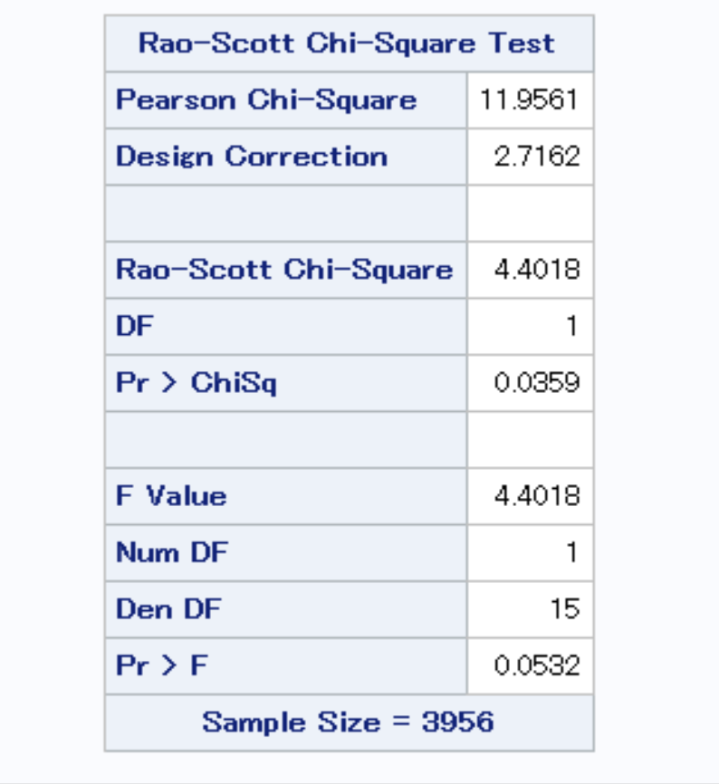
Binary Association Analysis (12)

Slide 44
Multivariate linear regression for LBXTC
proc surveyreg data=comb2;
class DMDMARTL RIAGENDR RIDRETH1;
model LBXTC=BPXDI1 BPXSY1 DMDHHSIZ DMDMARTL RIAGENDR RIDRETH1/solution;
weight WTMEC2YR;
strata SDMVSTRA;
cluster SDMVPSU;
run;

Slide 45
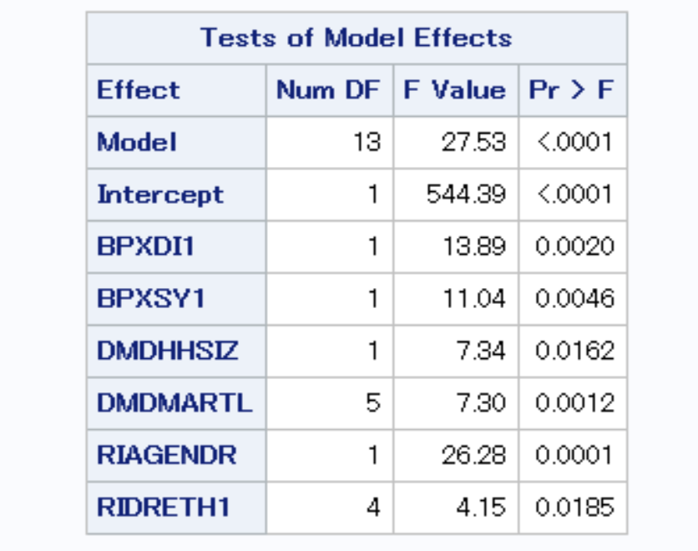
Multivariate linear regression for LBXTC (2)

Slide 46
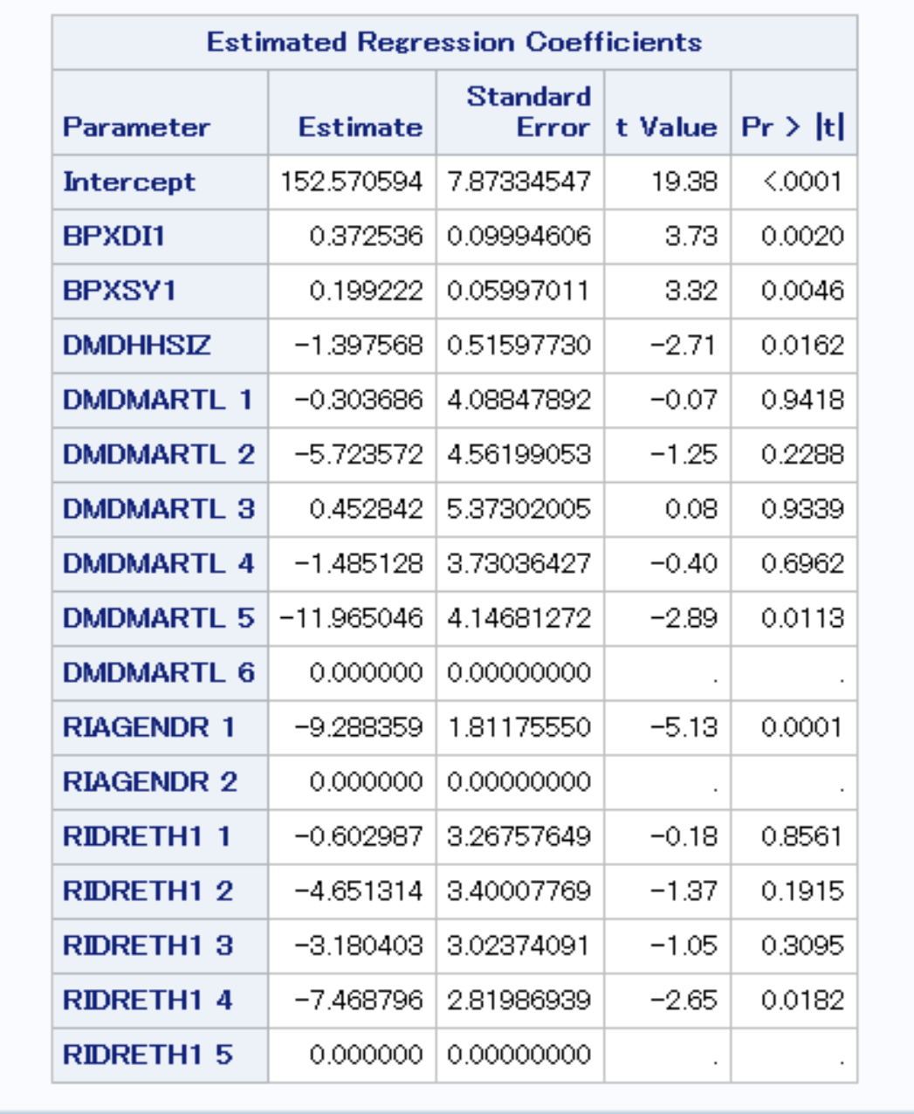
Multivariate linear regression for LBXTC (3)

Slide 47
Multivariate logistic regression for LBXTC2
proc surveylogistic data=comb2;
class DMDMARTL RIAGENDR;
model LBXTC2=BPXDI1 BPXSY1 DMDHHSIZ DMDMARTL RIAGENDR;
weight WTMEC2YR;
strata SDMVSTRA;
cluster SDMVPSU;
run;

Slide 48
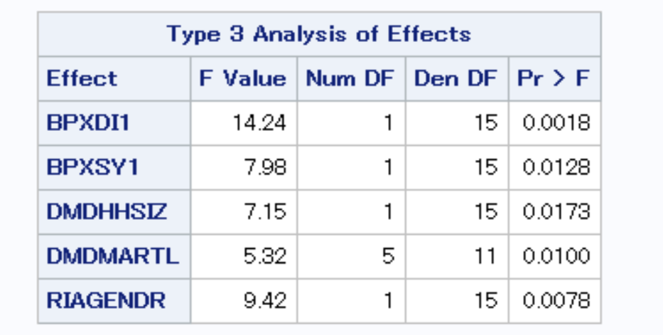
Multivariate logistic regression for LBXTC2 (2)

Slide 49
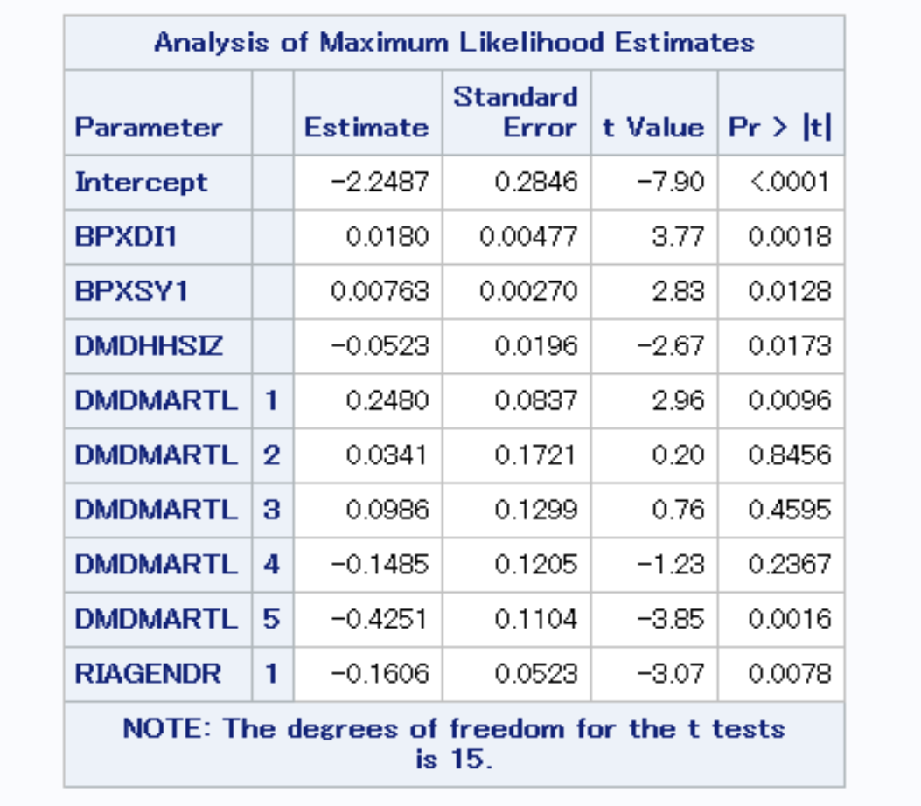
Multivariate logistic regression for LBXTC2 (3)

Slide 50
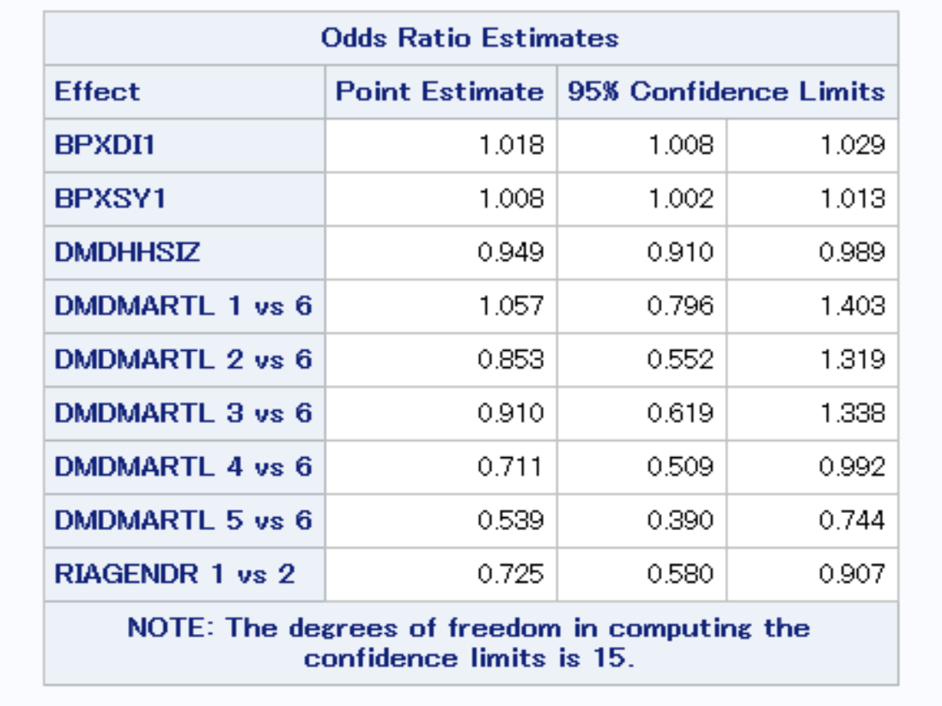
Multivariate logistic regression for LBXTC2 (4)

Slide 51
Other Topics
Generalized linear model: https://support.sas.com/resources/papers/proceedings14/1657-2014.pdf
Generalized linear mixed effect model
Imputation for survey data (PROC SURVEYIMPUTE)
Nonparametric methods
Visualization tools (Scatter plots, Boxplots, etc.)

Slide 52
BSE 5603: SAMPLING THEORY AND METHODS (3 credit hours)
Time: 2024 Spring
Course Description: To introduce various commonly used sampling methods including when and how to apply them, advantages and disadvantages, how to determine sample size, and the design of forms and questionnaires for data collection
Prerequisite: BSE 5013 001 Application of Microcomputers to Data Analysis AND BSE 5163 Biostatistics Methods I AND any one of BSE 5173 Biostatistics Methods II, 5643 Regression Analysis, 5663 Analysis of Frequency Data, or 6643 Survival Data Analysis AND Permission of Instructor

Slide 53
Data integration Short Course (Forthcoming)
Title: Introduction to Data Integration for Combining Probability and Non-Probability Samples
Instructor: Dr. Sixia Chen
Time (ET): Monday, May 1, 2023 1:00 PM - 4:30 PM
Organization: The American Association for Public Opinion Research
Website: https://portal.aapor.org/integratedEvents/home/INTRODUCTION-TO-DATA-INTEGRATION-FOR-COMBINING-PROBABILITY-AND-NON-PROBABILITY-SAMPLES

Slide 54
Thank you for your attention
Questions?
End of Workshop evaluation survey:
https://bbmc.ouhsc.edu/redcap/surveys/?s=KFRD3NDKKWLD9JME
Contact information: sixia-chen@ouhsc.edu

