Slide 1
Propensity Score Analysis in Epidemiologic Research:
An Introduction
OSCTR BERD WORKSHOP
May 18th , 2022
Tabitha Garwe, PhD MPH
Associate Professor
Director, Surgical Outcomes Research
Associate Director – BERD
Co-Director – BERD Clinical Epidemiology Unit

Slide 2
Background
RCT – gold standard study design: estimating the effects of treatments, interventions, and exposures
Random allocation: treatment assignment will not be confounded with either measured or unmeasured baseline characteristics.
Effect of treatment on outcomes estimated by comparing outcomes directly between treated and untreated subjects
In observational studies, exposure/intervention/treatment selection is often influenced by subject characteristics.
  Need to account for systematic differences in baseline characteristics between treated and untreated subjects when estimating treatment effect
  propensity score methods allow one to mimic some of the characteristics of an RCT

Slide 3
Counterfactual Model Framework
(aka Potential Outcomes Framework)
An individual typically has two potential outcomes:
    Y(1), the outcome that would be observed if the individual receives the treatment
    Y(0), the outcome that would be observed if the individual does not receive the treatment under identical circumstances to those under which the subject would have received the treatment
Average Treatment Effect (ATE)
  the average effect, at the population level, of moving an entire population from untreated to treated → PAR
Average Treatment Effect for the Treated(ATT)
  the average effect of treatment on those subjects
  who ultimately received the treatment → AR in Exposed

Slide 4
Counterfactual Model Framework
(aka Potential Outcomes Framework)
RCT – Potential outcomes in treated and untreated are unrelated to treatment assignment →treatment assignment given the variables X is strongly ignorable → ATE=ATT
  the treatment assignment Z and the response Y, are known to be conditionally independent given the covariates, X
    Crucial assumption in making a causal inference and underlies propensity score analyses
  every subject has a nonzero probability to receive either treatment.
Observational studies – Y(0) and Y(1) and the treatment assignment Z might not be independent - ATE and ATT are not the same
  Although not explicitly stated, assumption of strongly ignorable treatment assignment/no unmeasured confounding also underlies regression-based approaches when used to make a causal inference

Slide 5
Counterfactual Model Approach (Causality)
“Confounding/selection bias is present if the substitute population imperfectly represents what the target would have been like under the counterfactual condition”
Counterfactual,
unexposed cohort
Substitute, unexposed cohort
Maldonado & Greenland, Int J Epi 2002;31:422-29

Slide 6
Conventional Multivariable Analysis
‘Ignorability of treatment assignment?’
Standard output of regression modeling software generally does not alert the investigator to marked differences in the covariate distributions between treatment and control groups is a problem
Restrictions on the number of covariates that may be included in a given model
Integrating propensity scores with conventional multivariable techniques may adjust differences in covariates between two study groups and reduce bias better than conventional techniques alone

Slide 7
Example

Slide 9
Problem With Observational Studies in Studying Impact of Life-Saving Interventions on Outcomes: Confounding by Indication (Indication Bias)
‘ Markers’ of Severe Injury
In-hospital Mortality;
Complications
IVF status

Slide 10

Example

Slide 12
Propensity Scores
What is a propensity score? - Conditional probability, between 0 and 1, that a subject will be treated based on an observed group of covariates (Rosenbaum and Rubin, 1983)
Rosenbaum and Rubin in their seminal paper, showed that the propensity score is a balancing score and can be used in observational studies to reduce bias
Probability of treatment is explicitly defined in randomized trials
  propensity for treatment in any given subject is usually unknown in an observational study

Slide 13
Propensity Scores
For a specific value of the propensity score, the difference between the treatment and control means for all units with that value of the propensity score e(x) is an unbiased estimate of the average treatment effect
  Ignorability of treatment assignment - the treatment assignment T and observed variables X are conditionally independent given the propensity score Rosenbaum (2010)
A means of obtaining ‘quasi-randomization’ of treatment groups to minimize bias and to better estimate the true effect of treatment (D’Agostino, 1998)
  But unlike in a controlled experiment, treatment assignment conditional only on the observed covariates

Slide 14
Propensity scores – Value in Observational Studies
Balancing property underlies its value
  at any value of PS, the difference in exposed and unexposed is an unbiased estimate of the average “treatment” effect
  a means of creating quasi-randomization of treatment groups
Improved control for confounding/selection bias
Can yield a better balance of measured covariates than would be obtained under randomized treatment assignment (Joffe & Rosenbaum, 1999)

Slide 16
Propensity Scores: Estimation
Can be estimated using discriminant analysis or logistic regression.
  Estimates of probabilities of treatment assignment conditional on observed covariates obtained
  Observed covariates are assumed to have a multivariate normal distribution (conditional on Z, the treatment assignment) when discriminant analysis is used, whereas this assumption is not needed for logistic regression.
Recursive partitioning or tree-based methods (CART) and neural networks for estimating the propensity score have also been used

Slide 17
Propensity Scores:
Estimation Using Logistic Regression
Traditional multivariable
Propensity score modeling
  Can include interaction terms, quadratic terms, weak confounders
  Outcome variable should not be included in the model used to generate propensity scores.

Slide 18
Variable Selection for the PS Model
Simulation studies illustrate how the choice of variables that are included in a PS model can affect the bias, variance, and mean squared error of an estimated exposure effect
  Variables that are unrelated to the exposure but related to the outcome should always be included in a PS model →decrease the variance of an estimated exposure effect without increasing bias
  Including variables that are related to the exposure but not to the outcome → increase the variance of the estimated exposure effect without decreasing bias
    These make good instrumental variables
  In small studies, the inclusion of variables that are strongly related to the exposure but only weakly related to the outcome can be detrimental → increase in mean squared error
  Standard model-building tools designed to create good predictive models of the exposure will not always lead to optimal PS models
Include only variables that are measured at baseline and not post-baseline covariates that may be influenced or modified by the treatment.

Slide 19
Specifying a PS Model
Iterative approach [Rosenbaum and Rubin (1984)]
  specify an initial propensity score model
  Assess comparability of treated and untreated subjects
  Modify propensity score model if residual systematic differences between treated and untreated subjects are found to remain
    Include additional variables
    Add interactions between covariates that are already in the model
    Model the relationship between continuous covariates and treatment status using nonlinear terms (e.g., using cubic smoothing splines).

Slide 20
Balance Diagnostics
1. Graphical assessment and adequate overlap
  Comparing the distributions of the estimated propensity score between treated and untreated subjects
2. Univariate analysis adjusting for the propensity score
  Propensity-adjusted comparison is non-significant
3. Standardized differences
    Recommendations: -0.1 to 0.1 or -0.25 to 0.25
4. Variance ratios
  variances of baseline covariates in treated and untreated subjects and the ratio of these variances in both the unadjusted and propensity-adjusted sample

Slide 21
Graphical Assessment – Quintile Stratification
Propensity score is a scalar summary of all the observed background covariates
Stratification on it alone can balance the distributions of the covariates in the treated and control groups
Quintiles generally used
  Cochran(1968) - creating five strata removes 90 per cent of the bias due to the stratifying variable or covariate
  Rosenbaum & Rubin (1984) - found that using five strata based on the estimated propensity score was able to substantially reduce the bias when estimating a linear treatment effect

Slide 22
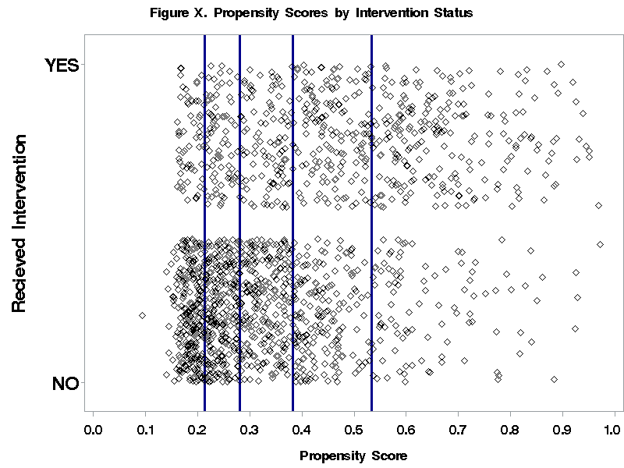

Slide 23

Example

Slide 24
Q-Q and Density Plots

Slide 25
Significance testing

Slide 26
Balance Diagnostics, cont’d
Comparing distributions and significance testing generally not recommended to assess baseline balance in a matched sample
  Similarity in distributions does not imply that measured baseline covariates have been balanced, nor does it imply that the propensity-score model has been correctly specified.
  Significance testing inappropriate mainly because apparent improvement in balance may be due to the reduced sample size.
AUC of the PS model?
  Cannot rely on AUROC to indicate whether the ps-model has been correctly specified
For a matched sample, standardized differences and variance ratios recommended

Slide 27
Austin P. C. (2009). Statistics in medicine, 28(25), 3083–3107.

Slide 28
Standardized Differences
Austin PC. Balance diagnostics for comparing the distribution of baseline covariates between treatment groups in propensity-score matched samples. Stat Med. 2009;28(25):3083-3107. doi:10.1002/sim.3697

Slide 29
Standardized Differences
Not influenced by sample size
Allows for the comparison of the relative balance of variables measured in different units
Generally a lack of consensus as to what value of a standardized difference denotes important residual imbalance
  Recommendations: -0.1 to 0.1 or -0.25 to 0.25
  threshold for acceptable imbalance depends, to some degree, on the prognostic importance

Slide 30
Variance Ratio
Can obtain a broader characterization (beyond means) of the similarity of the distribution of a continuous covariate between two groups →determine whether the propensity-score model has been correctly specified.

Slide 31
Example: Standardized Differences and Variance Ratios
Yuan et al. Propensity Score Methods for Causal Inference with the PSMATCH Procedure

Slide 32
Why Propensity Score Analysis?
Risk adjustment using traditional multivariable techniques such as logistic regression may be inadequate
    Much more difficult to determine whether the regression model relating treatment selection and baseline covariates to the outcome has been correctly specified →Implicit assumption of ignorability of treatment assignment unverifiable
Unlike an inferential model, both weak and strong confounders can be included in PS Model
Efficient data reduction technique
  Increased flexibility when outcomes (when binary or time-to-event in nature) are rare and treatment is common (recall recommended minimum EPV of 10)
Dual purpose – Question of interest, how well that can be answered
  Explicitly examine the degree of overlap in the distribution of baseline covariates between the two treatment groups

Slide 33
References
1. D'Agostino RB Jr. Propensity score methods for bias reduction in the comparison of a treatment to a non-randomized control group. Stat Med. 1998 Oct 15;17(19):2265-81.
2. Newgard CD, Hedges JR, Arthur M, Mullins RJ. Advanced statistics: the propensity score--a method for estimating treatment effect in observational research. Acad Emerg Med. 2004 Sep;11(9):953-61.
3. Austin P. C. (2011). An Introduction to Propensity Score Methods for Reducing the Effects of Confounding in Observational Studies. Multivariate behavioral research, 46(3), 399–424. https://doi.org/10.1080/00273171.2011.568786
4. Austin P. C. (2009). Balance diagnostics for comparing the distribution of baseline covariates between treatment groups in propensity-score matched samples. Statistics in medicine, 28(25), 3083–3107.

Slide 34
PART II: Integration Approaches
Propensity scores can be integrated into an analysis in a number of ways
Most common
  ‘Raw’ score regression adjustment
  Stratification
  Matching
Inverse probability of treatment weights (IPTW)
  Creates weights that are appropriate for estimating the ATE and ATT
  Allows for population based inferences, but results can be sensitive to estimated weights (in particular when outlier observations exist)

