Slide 1
Prior beliefs
Prior belief is knowledge that one has about a parameter of interest before any events have been observed
  For example, you may have an idea of what the prevalence of flu was last week.
Not all events can be observed without any bias
  Prior belief comes into play to know what the biases may be and how to adjust them.
  They are crucial to the estimation of sample sizes

Slide 2
Prior beliefs
The probability distribution functions learnt previously can be used to represent prior belief.
Prior beliefs can be elicited from 3 majors sources
  Previous meta analyses which results can be directly transformed into pdf to represent belief
  Previous literature but without meta analysis, which would require more work to put into pdf
  Experts’ opinion, which can be challenging to assess and to put into a pdf.

Slide 3
Eliciting prior beliefs from experts
Experts’ belief are most often measured as
  Beta(α,β) – for binomial outcomes
  Normal(μ,σ) – for continuous outcomes
The elements of the belief to be measured are
  Point estimates: means, medians and/or modes.
  Quantiles or variances that give the expert’s confidence in their point estimates.
  Co-variances that quantify relationships between the point estimates.
  (Others. e.g. point estimates of correlations)

Slide 4
Eliciting prior beliefs on proportions
Includes 2 tasks
  Eliciting the pdf (uncertainty, variance)
    “Let µ be the date in which the first human settlers arrived in Europe. What probability distribution represents your uncertainty about µ?”
    “Let µ be the proportion of adult males in the population who are involved in road accidents in the given year. What probability distribution represents your uncertainty about µ?”
  Eliciting the actual proportion (point estimate)
    “Estimate the probability of an adult male being involved in a road accident this year.”
Taken from Oakley et al. 2010

Slide 5
Eliciting prior beliefs on proportions
The way the questions are asked can influence the answer
  Recent experience with what is being measured
  Presenting the problem using percentages vs asking about X out of 100 or X out of 1000
  Anchoring (see later)
  Listing of options
Taken from J. Oakley (Ed.), Eliciting Univariate Probability Distributions, Risk Books, London (2010)

Slide 6
The psychology of eliciting beliefs
From Winkler, 1967:
  “The [expert] has no built-in prior distribution that is there for the taking. That is, there is no `true' prior distribution. Rather, the [expert] has certain prior knowledge which is not easy to express quantitatively without careful thought. An elicitation technique used by the [facilitator] does not elicit a `true' prior distribution, but in a sense helps to draw out an assessment of a prior distribution from the prior knowledge. Different techniques may produce different distributions because the method of questioning may have some effect on the way the problem is viewed."

Slide 7
Preparing the elicitation exercise
Make sure the expert understands the difference between eliciting a pdf vs a probability per se (ie a prevalence)
Clearly explain that precision is not the goal, uncertainty is
Give an example of the difference between randomness and uncertainty
Taken from J. Oakley (Ed.), Eliciting Univariate Probability Distributions, Risk Books, London (2010)

Slide 8
Preparing the elicitation exercise
Make sure the expert reflects his/her own uncertainty, not that of others
Explain why experts’ belief is important in contrast to collecting data.
In practice examples, get the expert to “react” to possible parameter values (should not be done in the actual elicitation)
Taken from J. Oakley (Ed.), Eliciting Univariate Probability Distributions, Risk Books, London (2010)
Notes:
Anexpert may find she can quickly judge another person's estimate to be too high or too low, which can then encourage her to think what values of µ she would find acceptable. This sort of reasoning can help lead on towards the sorts of probabilistic judgments required for elicitation.

Slide 9
Identifying the role of the elicitation
Strong, directly relevant evidence
  Experts may not be needed in such a situation
Indirectly relevant evidence
  For ex, data with misclassification error
  Could ask about Se/Sp of the measurement tool
  Could ask about another population
Expert opinion only
Taken from J. Oakley (Ed.), Eliciting Univariate Probability Distributions, Risk Books, London (2010)

Slide 10
Structuring the elicitation problem
From Smith (1998)
  “it is paramount to spend a significant proportion of my time eliciting structure: dependencies, functional relationships and the like.“
For ex, ask to list categories of a categorical variable before asking for uncertainty about their frequency
Ask to estimate a parameter and the ratio of one parameter to the other (instead of 2 dependent parameters)
Taken from J. Oakley (Ed.), Eliciting Univariate Probability Distributions, Risk Books, London (2010)

Slide 11
Steps in eliciting a distribution
1. The expert makes a small number of probabilistic judgments about µ.
2. The facilitator fits a suitable parametric probability distribution to the expert's judgments.
3. The facilitator reports features of the distribution back to the expert, and asks the expert whether the fitted distribution is an acceptable representation of her beliefs.
4. If the distribution is acceptable to the expert then the elicitation is concluded. Otherwise, the facilitator fits an alternative distribution, usually based on modified or additional probabilistic judgments from the expert.
Taken from J. Oakley (Ed.), Eliciting Univariate Probability Distributions, Risk Books, London (2010)

Slide 12
Methods to elicit knowledge
Fixed interval
  Expert is asked for probabilities of the form P(a < µ < b).
Variable interval
  Expert is asked for quantiles; for example, the expert is asked for the value a such that P(a <µ) = 0.25.
Software / R codes
  SHELF, MATCH
Taken from J. Oakley (Ed.), Eliciting Univariate Probability Distributions, Risk Books, London (2010)

Slide 13
Fixed interval – Probability method
The expert is asked to specify several probabilities of the form P(a < µ < b).
In MATCH, if the range of X is [0,1], then the default probabilities asked for are P(0 < X < 0.25), P(0.75 < X < 1) and P(0 < X < 0.5)
In the original method, the expert is asked for 5 probabilities (r is the mode here):
  p1 =P { Xmin < µ < r }
  p2 = P { Xmin < X < (Xmin + r)/2) }
  p3 = P { (r + µmax)=2 < µ < µmax}
  p4 = P {Xmin < µ < (Xmin + 3r)/4 }
  p5 = P { (3r + Xmax)/4 < µ < Xmax }
Very hard to achieve

Slide 14
Fixed interval - Roulette method
The expert is ask to first determine the interval of possible values
A graph with a fixed number of bins is generated
The expert is asked to place a pre-determined number of chips in the bins
See ex. in MATCH
Taken from: Morris et al. A web-based tool for eliciting probability distributions from experts. Environmental Modelling & Software 52 (2014) 1-4

Slide 15
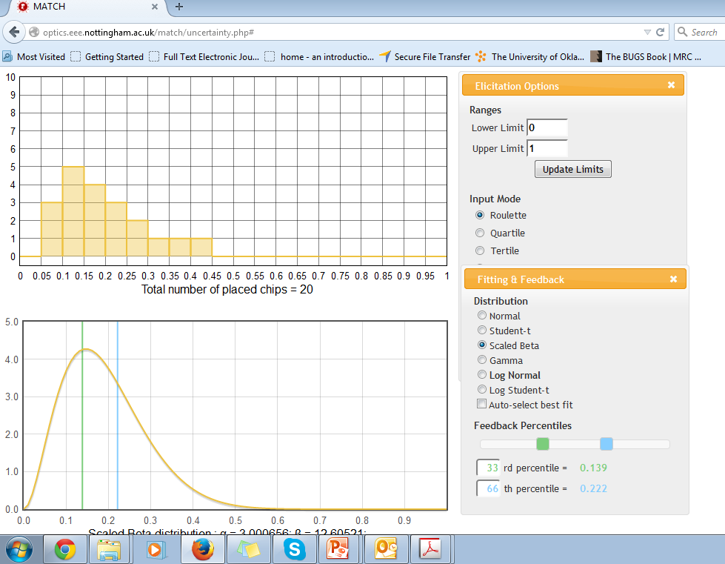
Ex. of roulette method in MATCH

Slide 16
Variable interval – bisection or quartile method
The expert specifies the median, lower quartile and upper quartile of X.
To assess median, the facilitator asks
  “Choose a value m, such that you judge the two intervals [0;m] and [m; 1] to have the same probability of containing µ.”
To ascertain quartiles, the facilitator asks
  “Divide the interval [0;m] into two equally probable intervals [0; l] and [l;m].”
The facilitator would then ask if the expert thinks that the intervals [0;l], [l;m], [m,u] and [u,1] all seem as probable as one another.
Then the pdf and the expert is asked if it reflects their belief.

Slide 17
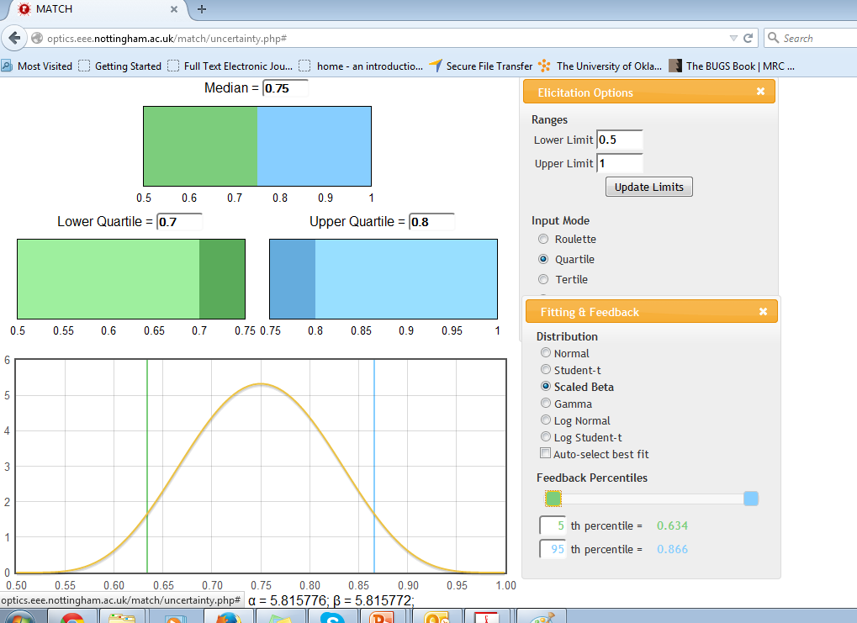
Ex of quartile method in MATCH

Slide 18
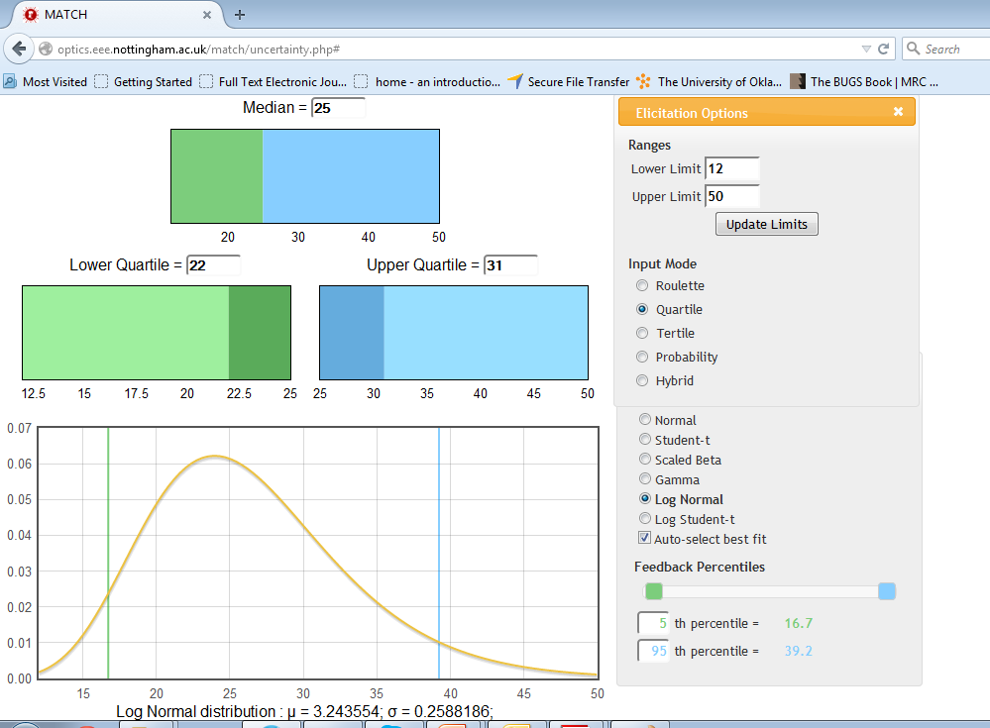
Ex with a continuous variable

Slide 19
Variable interval – tertile method
The expert specifies the median, the 33rd percentile and the 66th percentile.
The method is very similar to that of the quartile.
Experts may find it easier to divide their beliefs in thirds instead of quarters

Slide 20
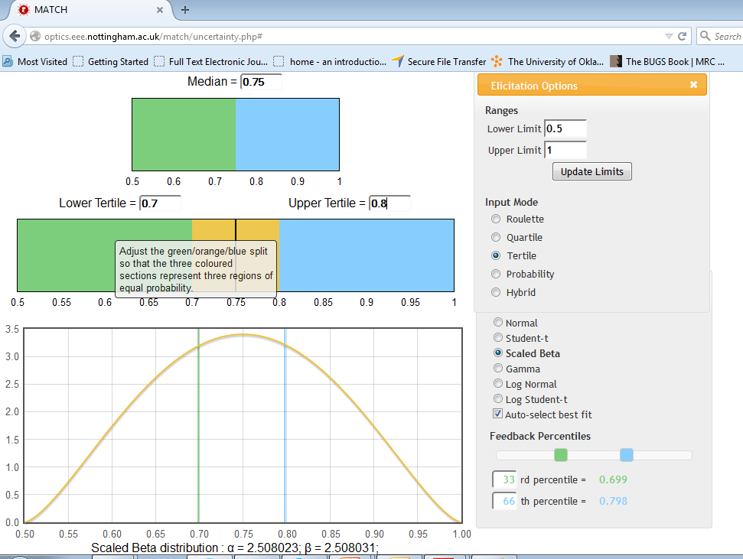
Ex of tertile method in MATCH

Slide 21
Feedback
After the pdf have been generated, then the facilitator will ask the expert questions about some values on the distribution. For example, how likely would a value corresponding to the 99th percentile be? Does it represent their beliefs etc. Values can be modified to best fit the belief of the expert.

Slide 22
4 principles of eliciting prior knowledge
Principle 1: It is desirable for elicitation methodologies to produce distributions which are flexible in form.
Principle 2: It is desirable to minimize the cognitive demands that an elicitation methodology places on the expert.
Principle 3: It is desirable to minimize the demands that an elicitation methodology places on the statistician.
Principle 4: All other things being equal, methodologies for prior elicitation which can be easily applied to a wide range of models or scenarios may have some added desirability.
Taken from Hahn., Re-examining informative prior elicitation through the lens of MCMC. Journal of the Royal Statistical Society: Series A 2006; 169, 37–48.
Notes:
Principle 1: It is desirable for elicitation methodologies to produce distributions which are flexible in form. Expert opinion is capable of taking on a wide range of possibilities and as such methodologies should be flexible enough to accurately capture a wide variety of distributions representing expert opinion. For example, distributions representing expert belief may possess skewness, heavy tails, or multiple modes. All other things being equal, elicitation methodologies should be capable of generating distributions which possess properties such as these in order to be faithful to expert opinion.
Principle 2: It is desirable to minimize the cognitive demands that an elicitation methodology places on the expert. Research suggests that simpler probabilistic judgment tasks are more likely to be accurately completed than are complex ones (Hogarth, 1975). Hence, tactics such as breaking
a complex judgment down into a series of more straightforward ones, or re-framing a question in terms of more easily envisaged contexts are likely to be beneficial. We also would want to consider addressing concerns about consistency among judgments. Requiring an expert to selfimpose perfect consistency among judgments while simultaneously rendering those judgments may be unduly challenging. Rather, a method which handles consistency issues adjunctively to the greater decision task may be preferable.
Principle 3: It is desirable to minimize the demands that an elicitation methodology places on the statistician. The widespread use of conjugate techniques suggests that this is an important concern. Methodologies which are cumbersome for the statistician to implement will be less attractive
than those which are not. Hence, developed methodologies should lend themselves readily to computational efforts.
Principle 4: All other things being equal, methodologies for prior elicitation which can be easily applied to a wide range of models or scenarios may have some added desirability. The vast majority of the methods mentioned in the above literature review were specifically tailored for a certain class
of model, or even a certain application. While it is desirable to have methodologies that are highly focused on certain problems, it would also be attractive to have more general methodologies that could be used in a variety of settings. Such approaches would minimize the need to invent and
validate elicitation methodologies on a case-by-case basis. For example, an approach that could be applied to real-valued parameters, strictly positive parameters, and parameters existing on the unit interval could save development work on the part of the statistician. Moreover, such a unified
approach might be helpful to the expert as only a single elicitation methodology needs to be learned.

