Slide 1
REDCap 101 An Introduction to REDCap
Thomas Wilson, MPH
Biomedical and Behavioral Methodology Core (ββϺC)
Department of Pediatrics, OU College of Medicine
Biostatistics and Epidemiology Research Design (BERD) Training Session
Department of Biostatics and Epidemiology, College of Public Health
December 11, 2015

Slide 2
What is REDCap?

Slide 3
First Steps: to request a REDCap account
Email redcap@ouhsc.edu – include a brief description of your project needs and include a phone number.
After your account is set up, you will receive information regarding the setup of your REDCap profile.
Enterprise REDCap instance can be accessed here: https://redcap.ouhsc.edu/
REDCap Contacts
Thomas Wilson: BBMC and Development Instances
thomas-wilson@ouhsc.edu
Ext. 42614
Pravina Kota: Enterprise and Development Instances
pravina-kota@ouhsc.edu
Ext. 48063

Slide 4
Training Outline
REDCap Appropriate Use Policy and Agreement
REDCap Login
REDCap Navigation
Data entry: Live in REDCap
Report generation: Live in REDCap

Slide 5
REDCap Appropriate Use Policy and Agreement
Obtain IRB approval prior to using REDCap for studies involving human participant research
Build the REDCap database in such a way that it corresponds to the study design that will be submitted to the IRB and provides proper data collection tools for all the data necessary for testing the study hypothesis
Collect all the data necessary for testing study hypothesis
Limit REDCap storage of PHI to the minimum that is reasonably necessary to conduct the research
Provisions for IRB auditing
Copies of the policy and agreement are posted online

Slide 6
First Steps: to request a REDCap account
Email redcap@ouhsc.edu – include a brief description of your project needs and include a phone number.
After your account is set up, you will receive information regarding the setup of your REDCap profile.
Enterprise REDCap instance can be accessed here: https://redcap.ouhsc.edu/
Logging on to REDCap
OUHSC Login Credentials
OUHSC Login ID
OUHSC Password
Includes OKC and Tulsa Campuses
Non-OUHSC Collaborators need to obtain an Affiliate Account ,email redcap@ouhsc.edu to request affiliate accounts.

Slide 7
Logging on to REDCap: redcap.ouhsc.edu

Slide 8
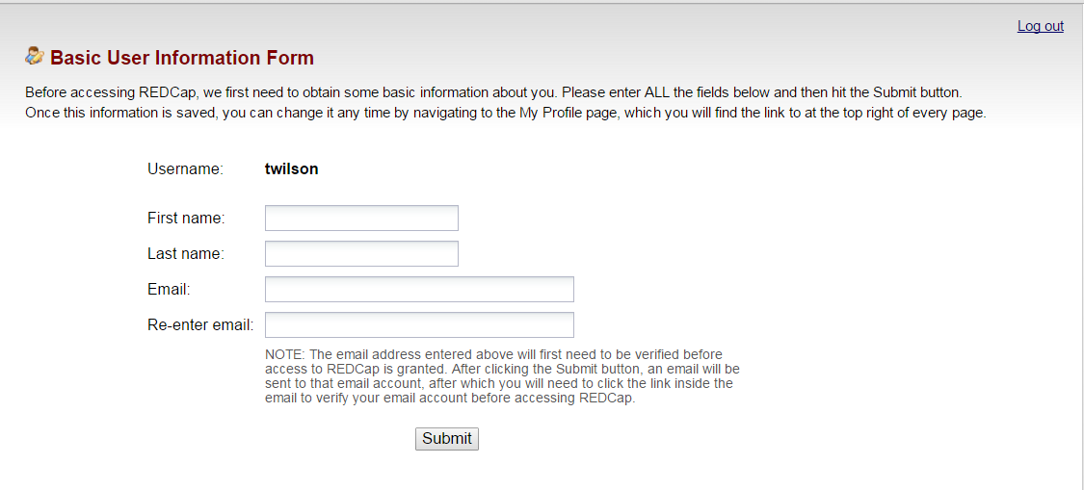
Logging on to REDCap (First Time Login)

Slide 9
Logging on to REDCap (First Time Login)

Slide 10
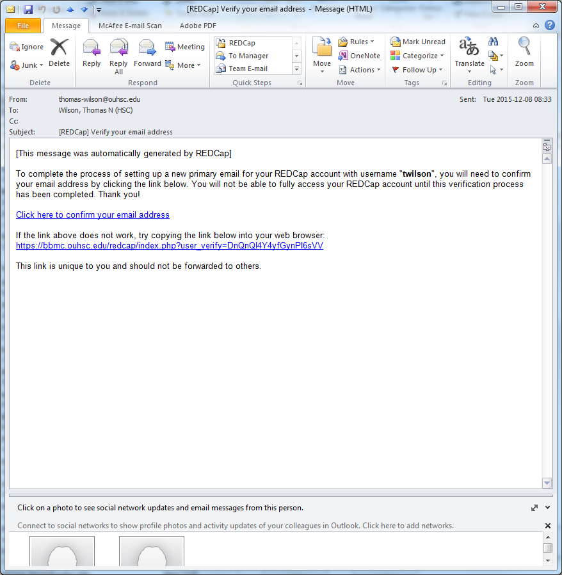
Logging on to REDCap (First Time Login)

Slide 11
Logging on to REDCap (First Time Login)

Slide 12
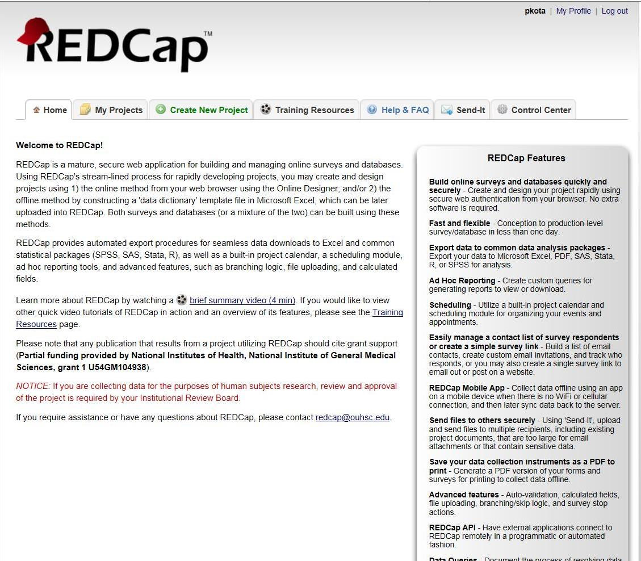
Navigating REDCap: Home

Slide 13
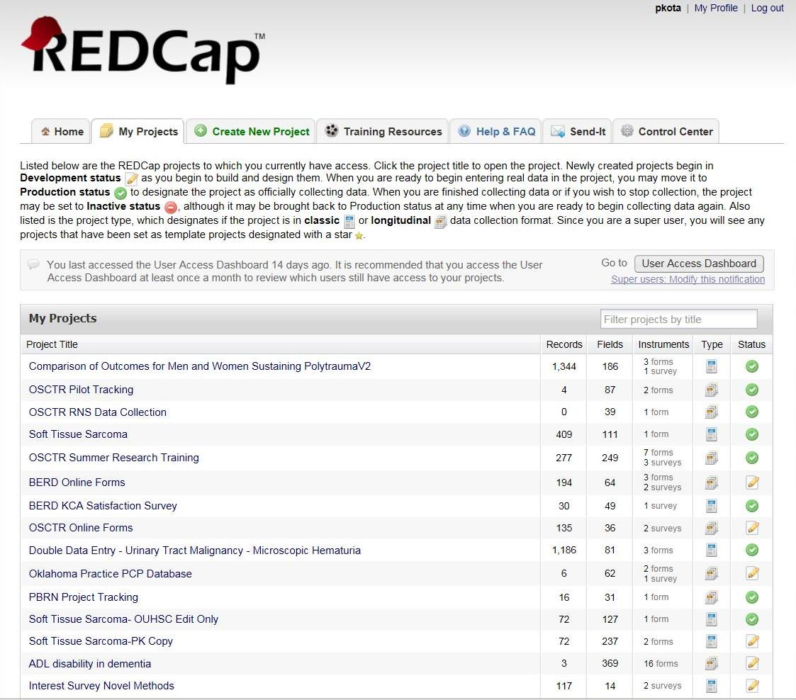
Navigating REDCap: My Projects

Slide 14
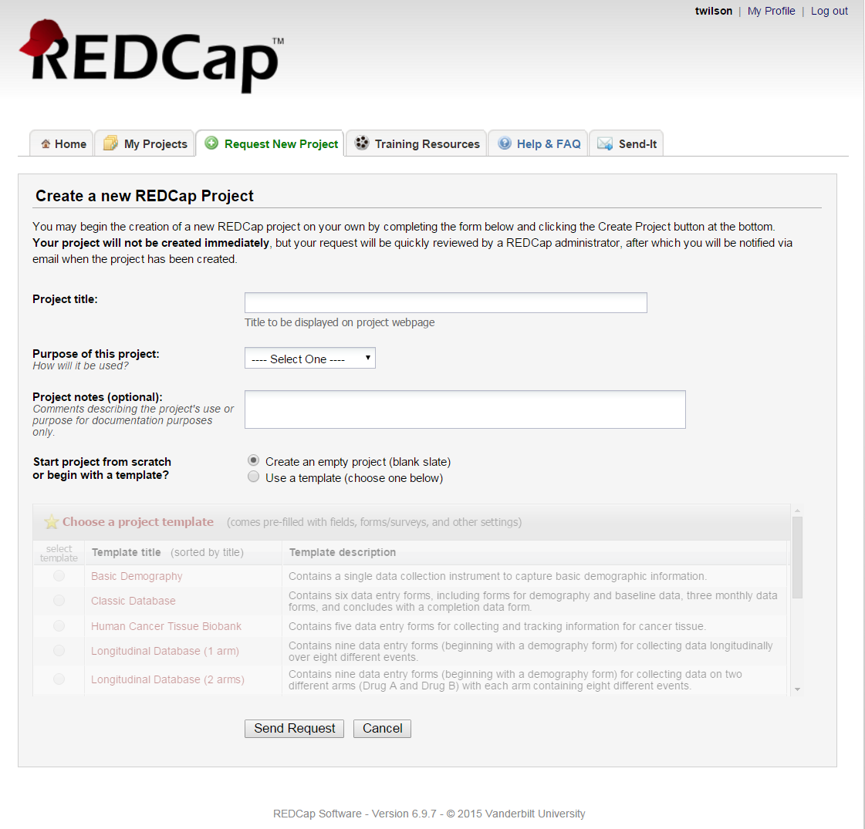
Navigating REDCap: Request New Project

Slide 15
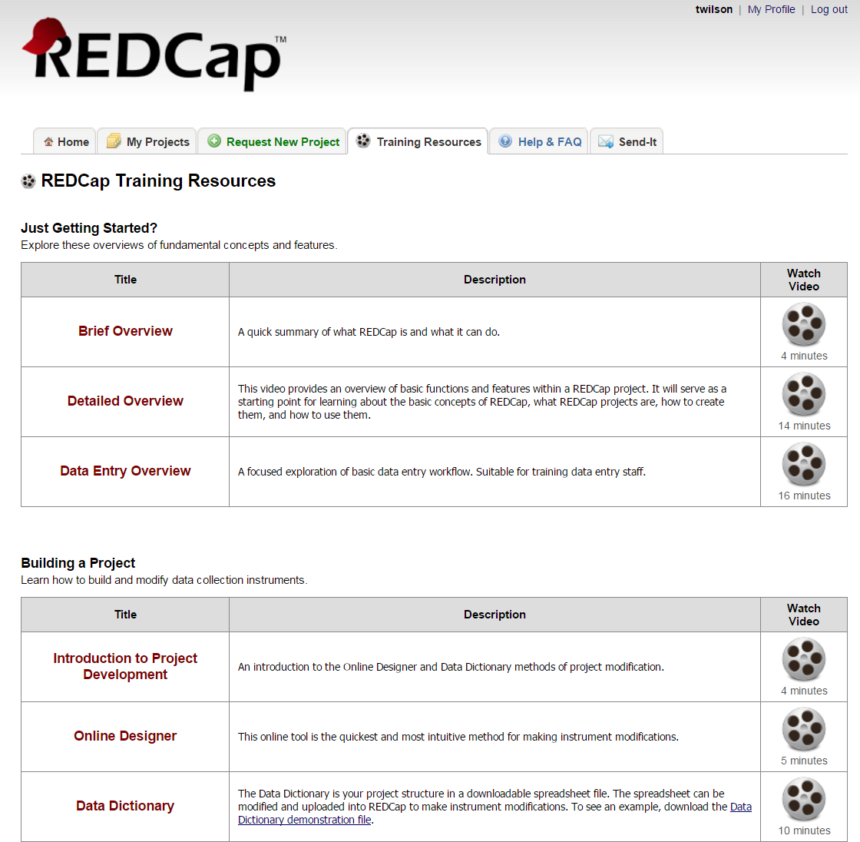
Navigating REDCap: Training Resources

Slide 16
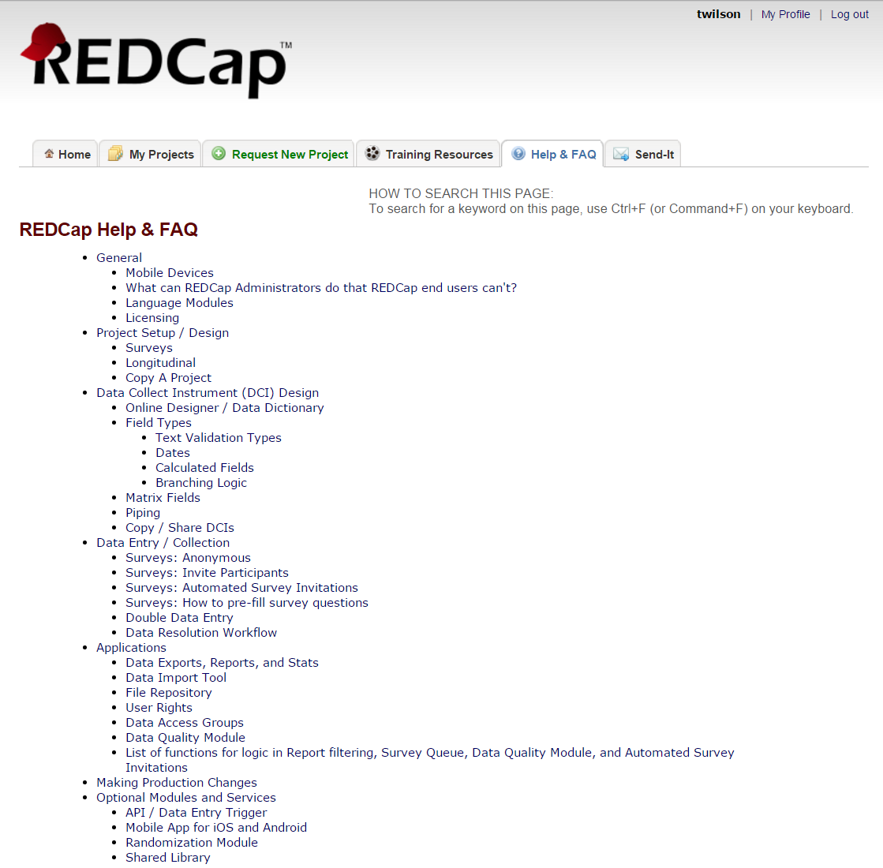
Navigating REDCap: Help & FAQ

Slide 17
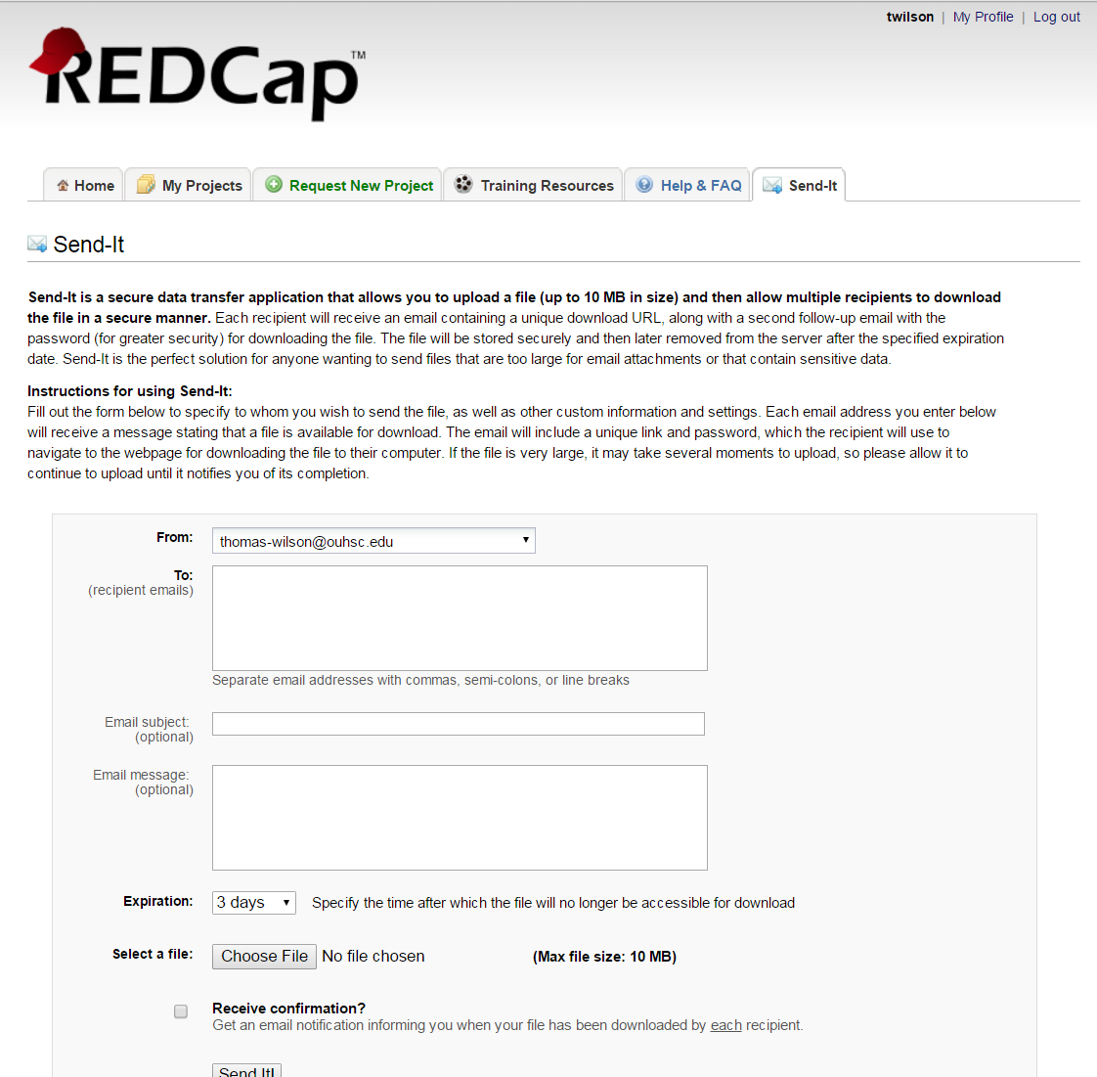
Navigating REDCap: Send-It

Slide 18
Data entry Variable Types
Text Box (Short Text)
Notes Box (Paragraph Text)
Calculated Field
Multiple Choice-Drop-down List (Single Answer)
Multiple choice-Radio Buttons (Single Answer)
Checkboxes (Multiple Answers)
Yes-No
True-False
Signature (draw signature with mouse or finger)
File Upload (for users to upload files)
Slide/Visual Analog Scale

Slide 19
Thank You!
http://ouhsc.edu/bbmc/
http://osctr.ouhsc.edu/
Comments or Questions???

