Slide 1
R Short Course Session 3
Daniel Zhao, PhD
Sixia Chen, PhD
Department of Biostatistics and Epidemiology
College of Public Health, OUHSC
3/9/2020

Slide 2
Outline
Scatter plot
QQ plot
Histogram
Curve
Bar chart
Pie chart
Stem and Leaf plot
Boxplot

Slide 3
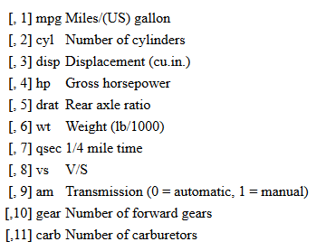
Data
mtcars: The data was extracted from the 1974 Motor Trend US magazine, and comprises fuel consumption and 10 aspects of automobile design and performance for 32 automobiles (1973–74 models).
?mtcars

Slide 4
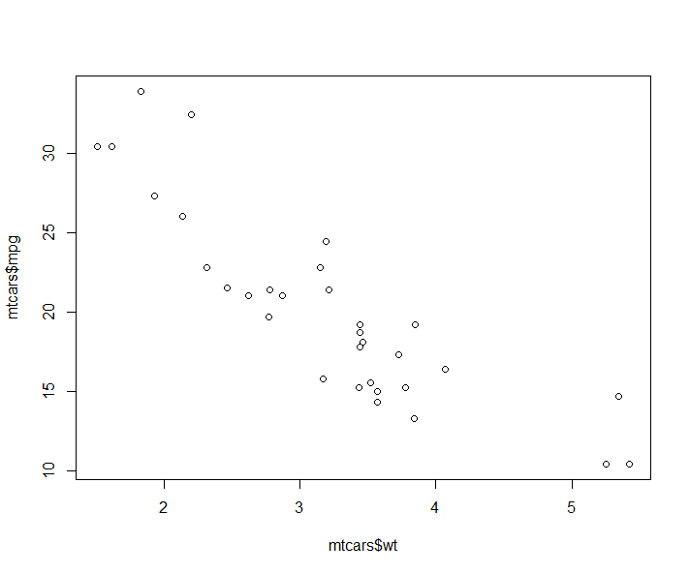
Scatter plot
Create scatter plot of vector y versus vector x: plot(x,y). E.g. plot(mtcars$wt, mtcars$mpg)

Slide 5
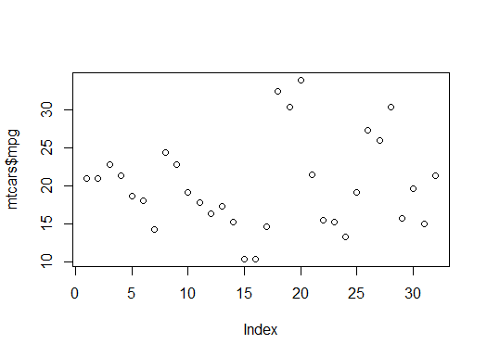
Scatter plot (2)
Create the scatter plot of x versus it’s index: plot(x). E.g. plot(mtcars$mpg)

Slide 6
Scatter plot (3)
Adding line: abline(a = NULL, b = NULL, h = NULL, v = NULL, reg = NULL, coef = NULL, ...)
#a is intercept
#b is slope
#h is horizontal line
#v is vertical line
#reg is regression line
#coef is coefficient of the line (intercept,slope)

Slide 7
Scatter plot (4)
For example:
plot(mtcars$wt, mtcars$mpg)
abline(h=20) #add horizontal line
abline(v=4) #add vertical line
reg<-lm(mtcars$mpg~mtcars$wt) #fitting regression model
abline(reg) #add regression fitted curve

Slide 8
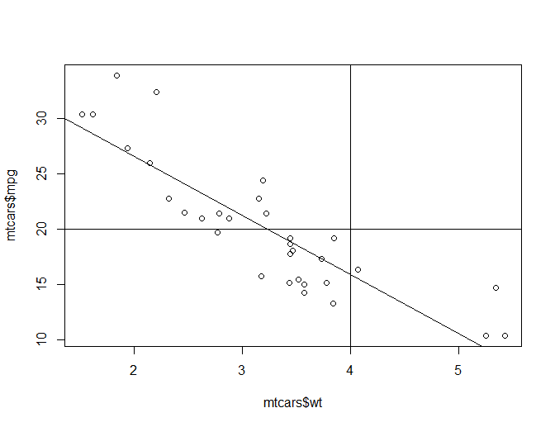
Scatter plot (5)

Slide 9
Scatter plot (6)
Adding title, modifying labels for x and y axis and adjusting the ranges of x and y axis:
plot(mtcars$wt, mtcars$mpg,main='scatter plot',sub='mpg vs weight',xlab='weight',ylab='mpg',xlim=c(0,7),ylim=c(5,40))
#main: main title, #sub: sub title, #xlab: x label, #ylab: y label, #xlim: range of x axis, #ylim: range of y axis

Slide 10
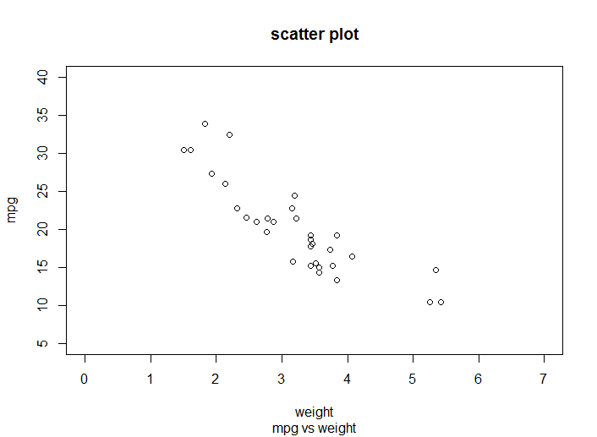
Scatter plot (7)

Slide 11
Scatter plot (8)
Modifying color, type, magnitude and so on of points and lines: par(cex=,col=,lty=,…)
?par
cex: magnitude of plotting text and symbols
col: plotting color
lty: line type
lwd: line width
pch: plotting symbol
…

Slide 12
Scatter plot (9)
Example:
par(pch=2,col=2,cex=1.5,cex.lab=2) #pch: type of point, #col: color of plot, #cex: magnitude of point, #cex.lab: magnitude of lab
plot(mtcars$wt, mtcars$mpg)

Slide 13
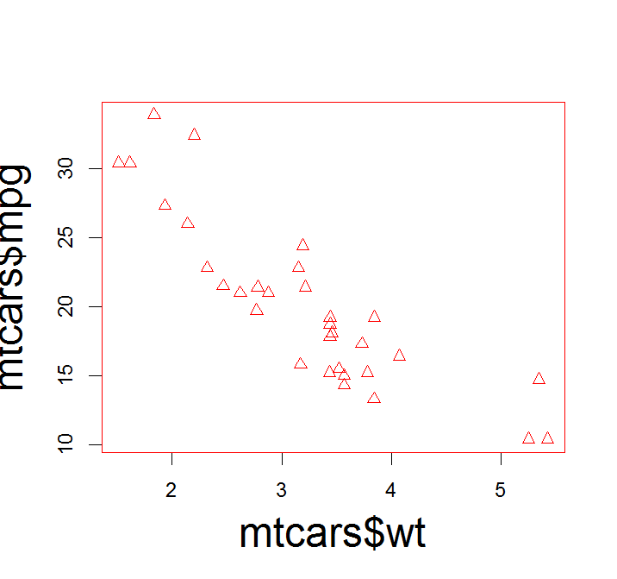
Scatter plot (10)

Slide 14
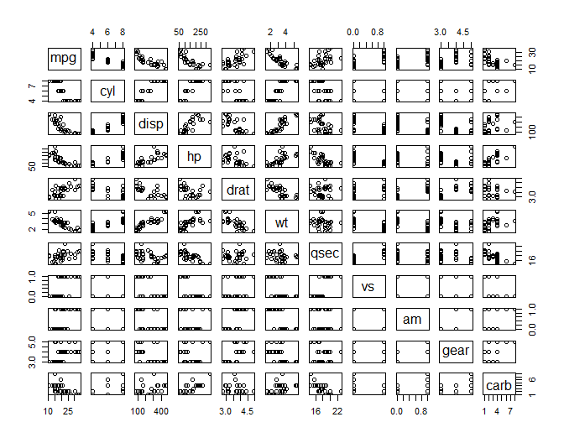
Scatter plot (11)
Pairwise scatter plot: Pairs(x)
Example: pairs(mtcars)

Slide 15
Scatter plot (12)
Adding points to the plot: points(x,y) #x,y: coordinate vectors of points to plot.
Example:
plot(-4:4, -4:4, type = "n") # setting up coord. system
points(rnorm(200), rnorm(200), col = "red") #rnorm(200) generates 200 obs from standard normal distribution
points(rnorm(100)/2, rnorm(100)/2, col = "blue", cex = 1.5)

Slide 16
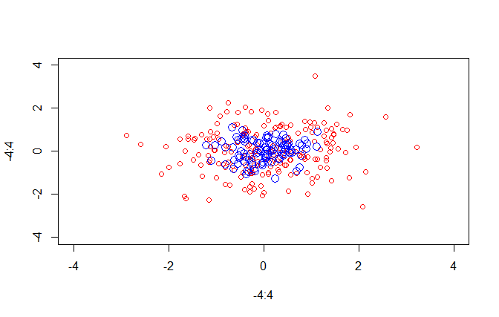
Scatter plot (13)

Slide 17
Scatter plot (14)
Adding segments to the plot: lines(x,y) #x,y are coordinate vectors of points to join
Example:
plot(-4:4, -4:4, type = "n") # setting up coord. system
points(rnorm(200), rnorm(200), col = "red")
lines(c(-2,0,2),c(-2,1,2))

Slide 18
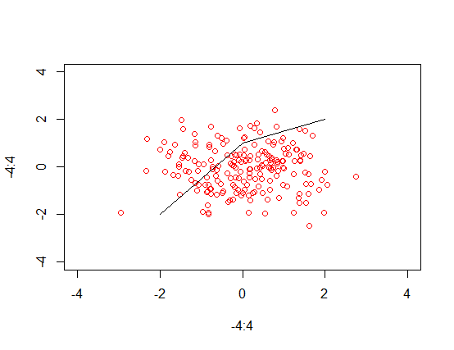
Scatter plot (15)

Slide 19
Scatter plot (16)
Adding Legend to the plot: legend(x,y,legend,pch,cex,col…) #x,y are the x and y coordinates to be used to position the legend, #legend is a character to appear in the legend

Slide 20
Scatter plot (17)
Example:
plot(-4:4, -4:4, type = "n") # setting up coord. system
points(rnorm(200), rnorm(200), col = "red")
points(rnorm(100)/2, rnorm(100)/2, col = "blue", cex = 1.5)
legend(2,3,legend=c('Dist1','Dist2'),pch=c(1,1),cex=1,col=c("red","blue"))

Slide 21
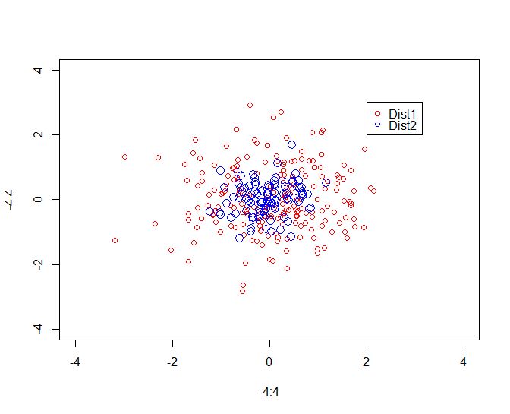
Scatter plot (18)

Slide 22
Scatter plot (19)
Present multiple plots together: par(mfrow=c(m,n)) #create m by n dimensional plots
Example:
par(mfrow=c(2,3)) #define the parameter to create 2 by 3 dimensional plot
plot(mtcars$wt,mtcars$mpg)
plot(mtcars$wt,mtcars$disp)
plot(mtcars$wt,mtcars$hp)
plot(mtcars$wt,mtcars$drat)
plot(mtcars$wt,mtcars$qsec)
plot(mtcars$mpg,mtcars$qsec)

Slide 23
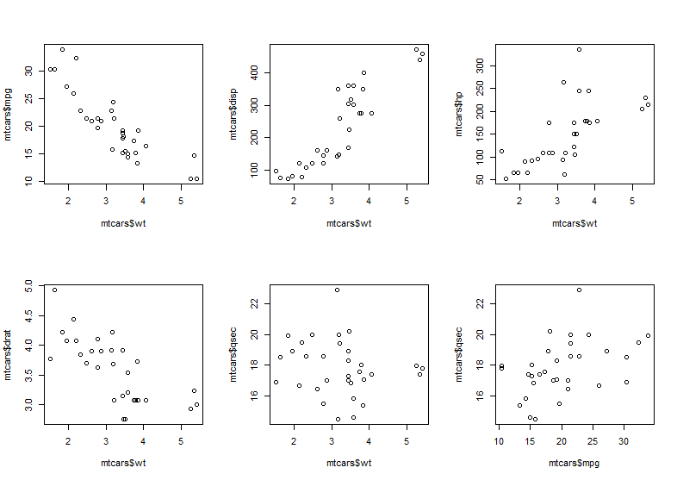
Scatter plot (20)

Slide 24
Scatter plot (21)
Add a smooth curve computed by loess (locally weighted scatterplot smoothing) to a scatter plot: scatter.smooth(x,y)
Example:
plot(mtcars$wt, mtcars$mpg)
scatter.smooth(mtcars$wt, mtcars$mpg)

Slide 25
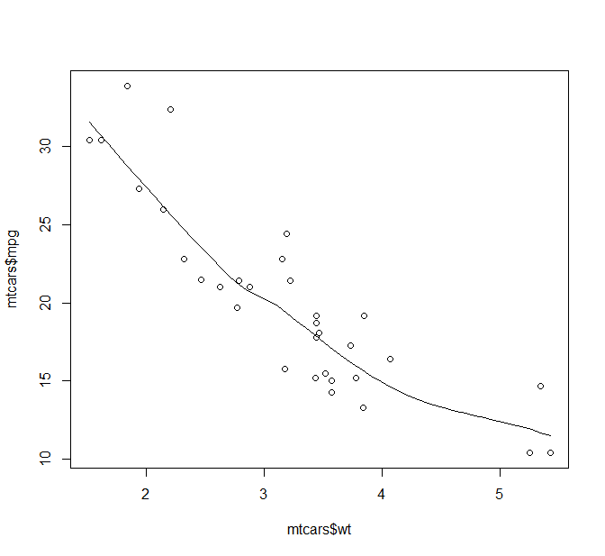
Scatter plot (22)

Slide 26
QQ plot
qqnorm(x) #add sample quantiles vs theoretical quantiles points from normal distribution
qqline(x) #add line of y=x
qqplot(x,y) #produce QQ plot of two vectors
abline(0,1) #add line of y=x

Slide 27
QQ plot (2)
Example:
par(mfrow=c(1,2))
x <- rt(100, df=3)
Normal fit: qqnorm(x); qqline(x)
t(3Df) fit: qqplot(rt(1000,df=3), x, main="t(3) Q-Q Plot",ylab="Sample Quantiles");
abline(0,1)

Slide 28
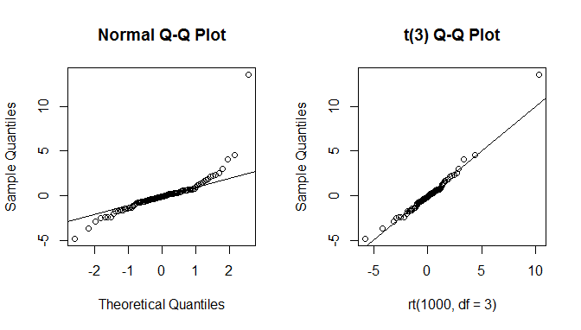
QQ plot (3)

Slide 29
Histogram
Generate histogram: hist(x,breaks=,prob=)
Example:
set.seed(11091951); #set up the random seed
x<-rgamma(100,10) #generate 100 obs from gamma distribution with shape parameter equals to 10
par(mfrow=c(2,2))
hist(x)

Slide 30
Histogram (2)
Example (cont’d)
hist(x,breaks=20,xlim=c(0,25),ylim=c(0,15))
hist(x,breaks=10,prob=T,main=c('probability'),xlab='x value',ylab='prob',col='blue',border = "purple")
hist(x,breaks=10,prob=T,xlim=c(0,25),ylim=c(0,0.15)); xd<-seq(from=0,to=30,length=1000); yd<-dgamma(xd,shape=10); lines(xd,yd); abline(h=0)

Slide 31
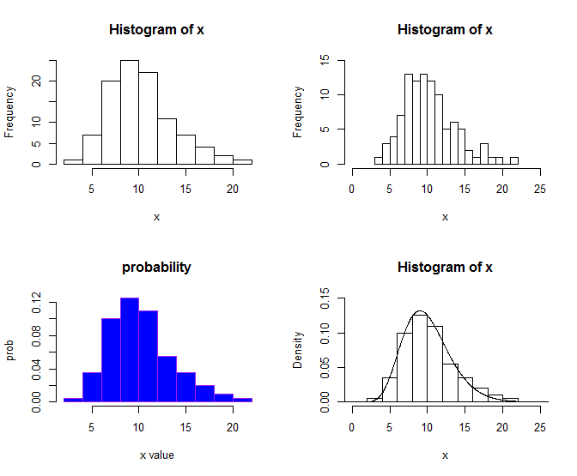
Histogram (3)

Slide 32
Histogram (4)
Fit density curve by using Kernel smoothing method: density()
Example:
set.seed(11091951); x<-rgamma(100,10)
hist(x,prob=T,breaks=20,xlim=c(0,25),ylim=c(0,0.15))
d<-density(x)
lines(d)

Slide 33
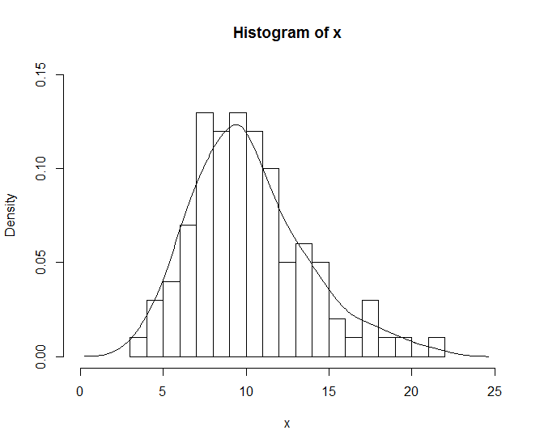
Histogram (5)

Slide 34
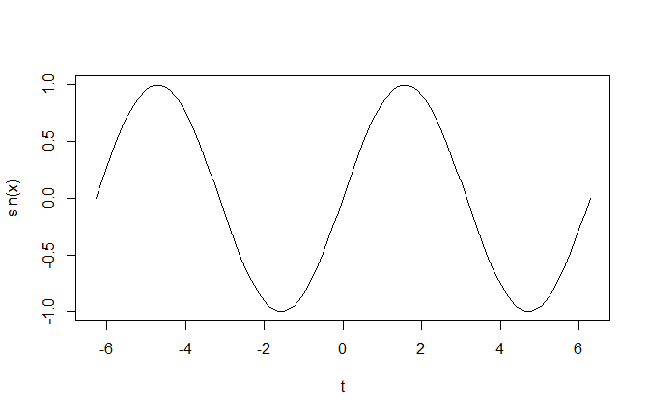
Curve
Draw the curve according to some function: curve()
Example: curve(sin, -2*pi, 2*pi,xname='t')

Slide 35
Bar Chart
Create Bar Chart: barplot(height=) #either a vector or matrix of values describing the bars which make up the plot
Example:
par(mfrow=c(2,2))
counts <- table(mtcars$gear); barplot(counts, main="Car Distribution",xlab="Number of Gears")

Slide 36
Bar Chart (2)
Example (Cont’d)
counts <- table(mtcars$gear); barplot(counts, main="Car Distribution", horiz=TRUE,names.arg=c("3 Gears", "4 Gears", "5 Gears"))
counts <- table(mtcars$vs, mtcars$gear); barplot(counts, main="Car Distribution by Gears and VS",xlab="Number of Gears", col=c("darkblue","red"),legend = rownames(counts))
counts <- table(mtcars$vs, mtcars$gear); barplot(counts, main="Car Distribution by Gears and VS",xlab="Number of Gears", col=c("darkblue","red"),legend = rownames(counts), beside=TRUE)

Slide 37
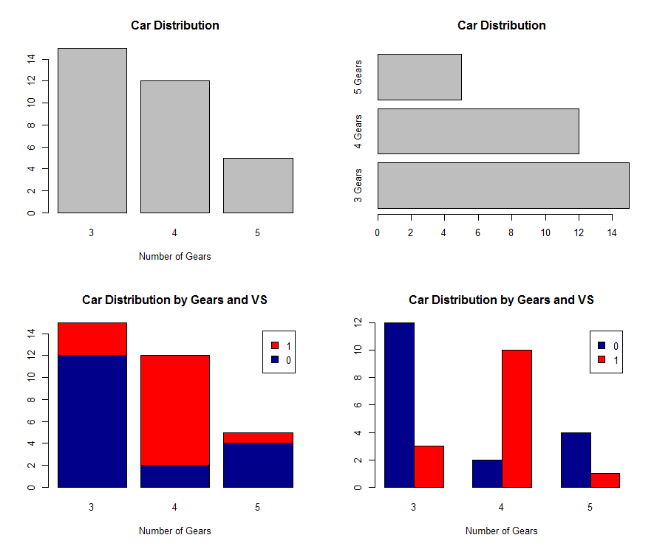
Bar Chart (3)

Slide 38
Bar Chart (4)
Create Error Bars: error.bar()
error.bar() function:
error.bar <- function(x, y, upper, lower=upper, length=0.1,...){
if(length(x) != length(y) | length(y) !=length(lower) | length(lower) != length(upper))
stop("vectors must be same length")
arrows(x,y+upper, x, y-lower, angle=90, code=3, length=length, ...)
}
#x is the result from barplot, #y is the mean, #upper is the standard error times 1.96

Slide 39
Bar Chart (5)
Create error bars example:
y <- rnorm(500, mean=1)
y <- matrix(y,100,5)
y.means <- apply(y,2,mean)
y.sd <- apply(y,2,sd)
barx <- barplot(y.means, names.arg=1:5,ylim=c(0,1.5), col="blue", axis.lty=1, xlab="Replicates", ylab="Value (arbitrary units)")
error.bar(barx,y.means, 1.96*y.sd/10)

Slide 40
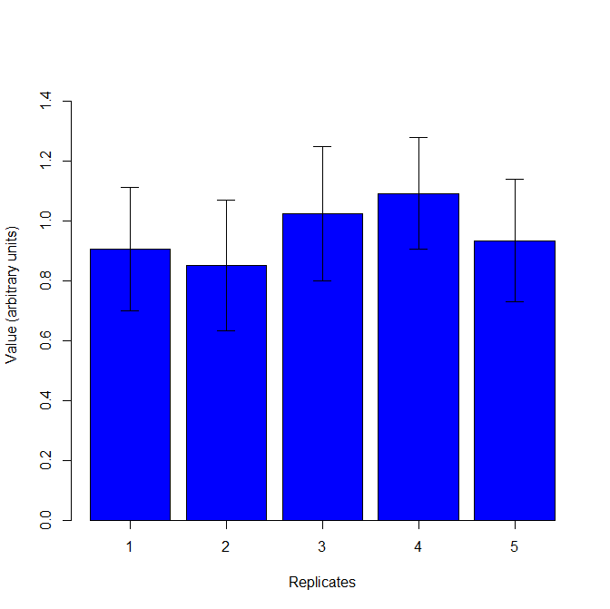
Bar Chart (6)

Slide 41
Pie Chart
Create Pie Chart: pie(), pie3D()
Example:
par(mfrow=c(2,2))
# Simple Pie Chart
slices <- c(10, 12,4, 16, 8)
lbls <- c("US", "UK", "Australia", "Germany", "France")
pie(slices, labels = lbls, main="Pie Chart of Countries")

Slide 42
Pie Chart (2)
Example (Con’t)
# Pie Chart with Percentages
slices <- c(10, 12, 4, 16, 8)
lbls <- c("US", "UK", "Australia", "Germany", "France")
pct <- round(slices/sum(slices)*100)
lbls <- paste(lbls, pct) # add percents to labels
lbls <- paste(lbls,"%",sep="") # ad % to labels
pie(slices,labels = lbls, col=rainbow(length(lbls)),main="Pie Chart of Countries")

Slide 43
Pie Chart (3)
Example (Con’t)
# 3D Exploded Pie Chart
library(plotrix)
slices <- c(10, 12, 4, 16, 8)
lbls <- c("US", "UK", "Australia", "Germany", "France")
pie3D(slices,labels=lbls,explode=0.1,main="Pie Chart of Countries ")
# Pie Chart from data frame with Appended Sample Sizes
mytable <- table(iris$Species)
lbls <- paste(names(mytable), "\n", mytable, sep="")
pie(mytable, labels = lbls,main="Pie Chart of Species\n (with sample sizes)")

Slide 44
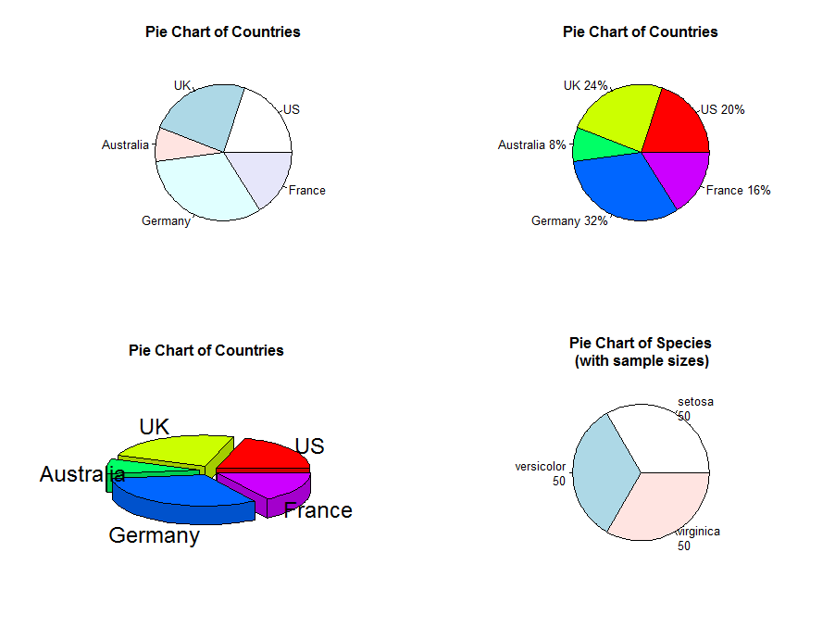
Pie Chart (4)

Slide 45
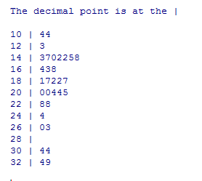
Stem and Leaf Plot
Create Stem and Leaf Plot: stem()
Example: stem(mtcars$mpg,scale=1)

Slide 46
Boxplot
Create Boxplot: boxplot()
Example: boxplot(mpg~cyl,data=mtcars, main="Car Milage Data", xlab="Number of Cylinders", ylab="Miles Per Gallon")

Slide 47
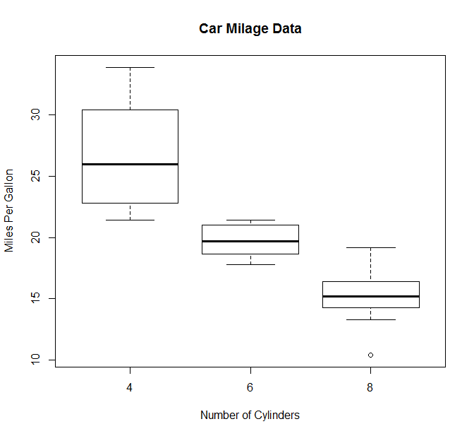
Boxplot (2)

Slide 48
R Books
R Graphics, Second Edition by Paul Murrell
R Graphics Cookbook by Winston Chang

Slide 49
R Online Resources
Search Engines with the right key words
UCLA resources to learn and use R
http://www.ats.ucla.edu/stat/r/
http://stackoverflow.com/
CRAN Task Views allow you to browse packages by topic
https://cran.r-project.org/web/views/
Eg, click on cluster will get a list of all cluster analysis R packages

